Slide 1
Unit Three Theme: The United States Constitution
Unit Essential Question:
How did compromise, conflict, and change lead to the ratification of the United States Constitution?

Slide 2
System of government set up right after signing of the Declaration of Independence
Idea proposed by Benjamin Franklin
Committee of 13 appointed to develop the Articles of Confederation

Slide 3
Questions for the Committee of 13
How strong should the central government be?
What form should it take:
Democracy
Republic
Monarchy
How do we go about creating it?
Who should be the King?

Slide 4
Articles of Confederation
Adopted in 1777
Name: United States of America
Each state retains its sovereignty
The U.S.A. is not sovereign itself

Slide 5
Articles of Confederation
Name: United States of America
Each state retains its sovereignty
The U.S.A. is not sovereign itself
Freedom of movement between states
Central government to use states’ money
One vote in Congress for each state

Slide 6
Articles of Confederation
Name: United States of America
Each state retains its sovereignty
The U.S.A. is not sovereign itself
Freedom of movement between states
Central government to use states’ money
One vote in Congress for each state
Debts of the U.S.A. are to be paid by the states
Canada can join the Confederation if it chooses
The Articles of Confederation are perpetual and can only be changed by Congressional approval and unanimous ratification from each state

Slide 7
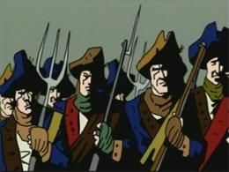
Life under the Articles of Confederation
Britain blocks all trade in British Ports
High inflation
John Adams appointed America’s first Ambassador to Britain
Shay’s Rebellion: Confederate money is worthless so Massachusetts
taxes farmers and they rebel
led by veteran Daniel Shays.

Slide 8
Land Ordinance of 1785
Confederacy has no authority to tax, so it plans to sell land in the new territory to raise money.
Systems of surveying lands

Slide 9
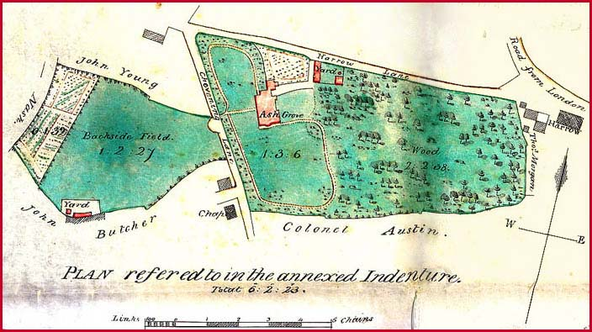
Metes and Bounds

Slide 10
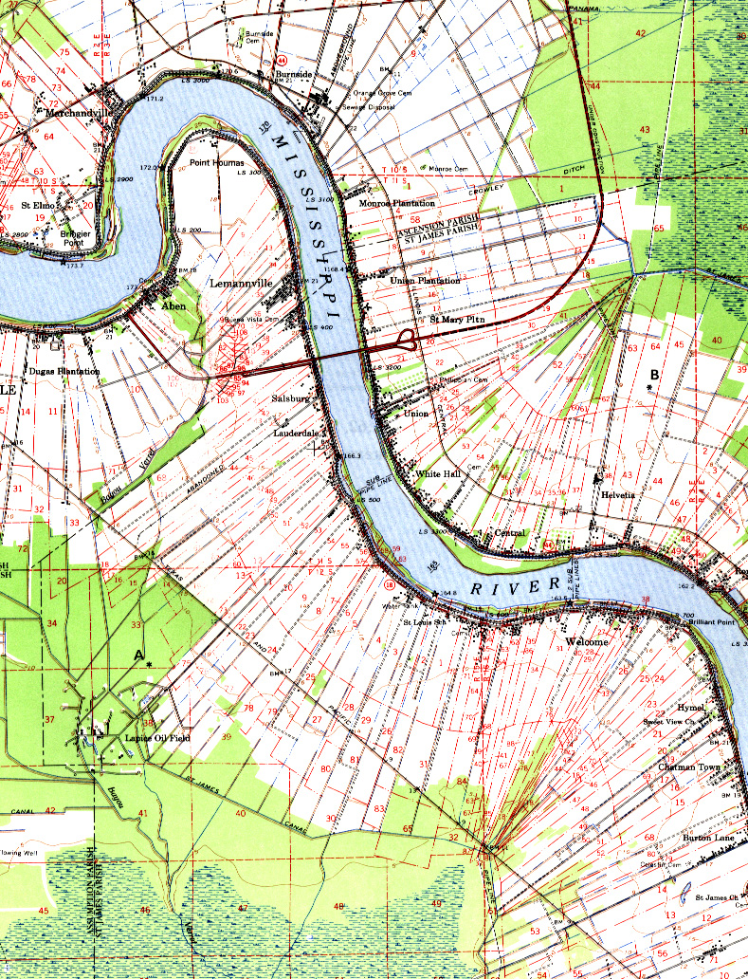
French System of Land Division

Slide 11
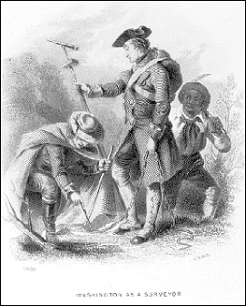
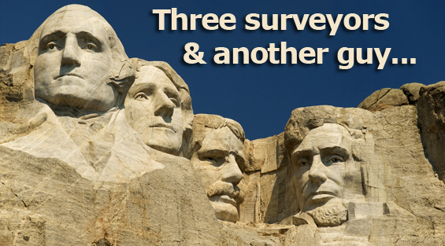

Slide 12
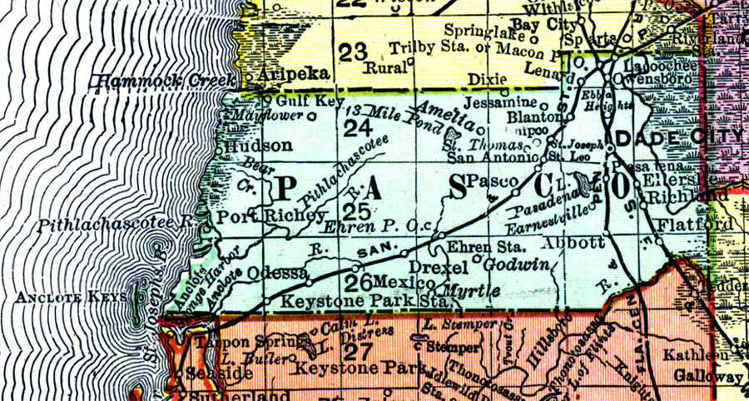
Township Map
Land Ordinance of 1785

Slide 13
Northwest Ordinance of 1787
Laws that govern the new Northwest Territory
How can new states enter the Confederation?
Slavery in the Northwest Territory is banned
Schools in each township are established (the birth of the one room school house)

Slide 14
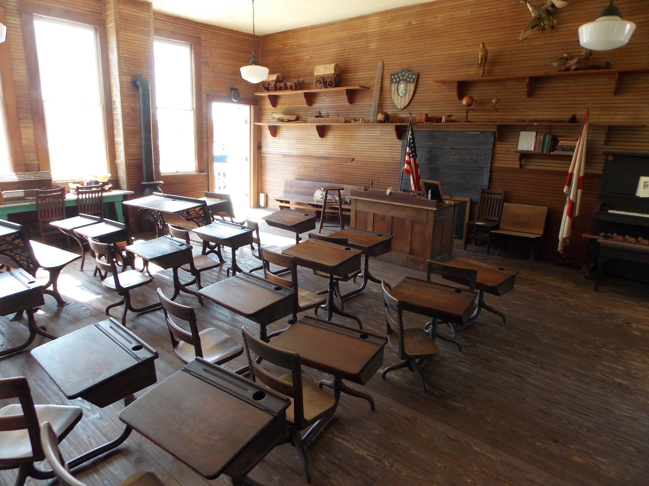

Slide 15
Journal: Northwest Territory
The Northwest Territory has been opened for settlement. Land is incredibly cheap! Will your character move? Why or why not? What challenges would your character encounter?
1 Paragraph
Due end of class

Slide 16
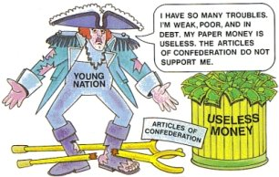
Weaknesses of the Articles of Confederation
No Money

Slide 17
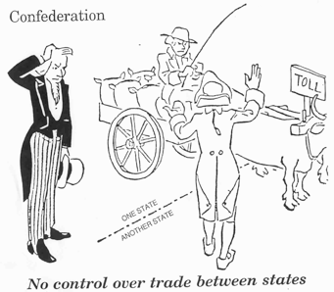
Weaknesses of the Articles of Confederation
No Money
No power to regulate trade

Slide 18
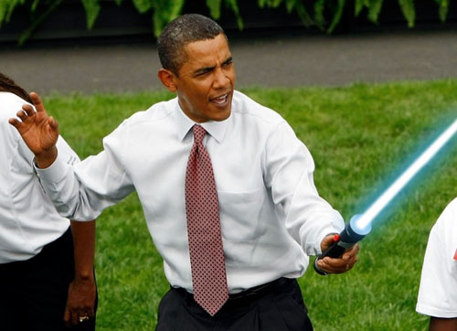
Weaknesses of the Articles of Confederation
No Money
No power to regulate trade
No Executive
Branch

Slide 19
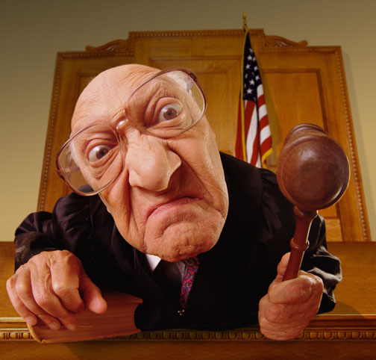
Weaknesses of the Articles of Confederation
No Money
No power to regulate
trade
No Executive Branch
No Judicial Branch

Slide 20
Weaknesses of the Articles of Confederation
No Money
No power to regulate
trade
No Executive Branch
No Judicial Branch
No Checks & Balances

Slide 21
Constitutional Convention
http://www.dailymotion.com/video/xx4eag_the-birth-of-the-constitution_lifestyle

Slide 22
Federalists
Want a strong central government (Constitution)

Slide 23
Federalists
Want a strong central government (Constitution)
Not an official political party but think of today’s Democratic Party
Men who were Federalists
James Madison
George Washington
Ben Franklin
Alexander Hamilton
John Adams
John Jay
John Hancock
Paul Revere

Slide 24
Anti Federalists
Want a strong state governments (keep the Articles of Confederation)

Slide 25
Anti Federalists
Want a strong state governments (keep the Articles of Confederation)
Not an official political party but think of today’s Republican Party
Men who were Anti Federalists
Samuel Adams
Patrick Henry
John Dickenson
Richard Henry Lee
George Mason
Thomas Jefferson
DeWitt Clinton
Eldridge Gerry

Slide 26
Federalist Papers
Essays written to convince the American people to support the new Constitution
Reassured the citizenry that the central government would not overpower the states
Printed in newspapers all over the country

Slide 27
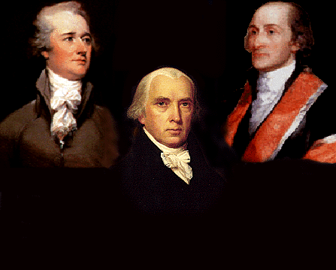
Federalist Papers
Alexander Hamilton
John
Jay
James Madison

Slide 28
Journal: Articles of Confederation or Constitution
Your character lives under a system of government in which the powers of the states dominate the central government. Your character has read the Federalist Papers. Describe your character’s opinion on whether to keep the old system or embrace the Constitution.
½ page
Due end of class

Slide 29
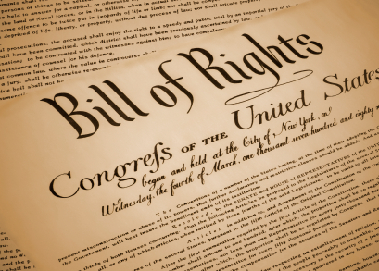

Slide 40
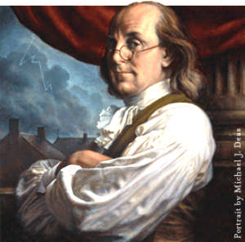
Mr. Heffron’s Favorite Patriot
Benjamin
Franklin

Slide 41
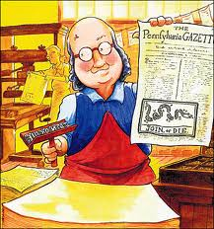

Slide 42
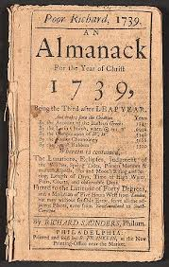

Slide 43
Ben Franklin Quotes
Fish and visitors stink after three days.
Three may keep a secret, if two of them are dead.
Early to bed and early to rise, makes a man healthy, wealthy, and wise.
He that lieth down with Dogs, shall rise up with Fleas.
Those who in quarrels interpose, must often wipe a bloody nose.
Glass, China, and Reputation, are easily crack'd, and never well mended.
An ounce of prevention is worth a pound of cure.

Slide 44
Ben Franklin Quotes
We must all hang together, or assuredly we shall all hang separately.
Courteous Reader Remember that time is money.
There was never a good war or a bad peace.
Our new Constitution is now established, and has an appearance that promises permanency; but in the world nothing can be said to be certain except death and taxes.
Genius without education is like silver in the mine.
A penny saved is a penny earned.

Slide 45
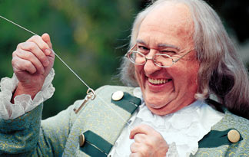

Slide 46
