Slide 1
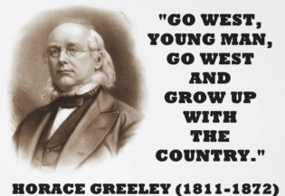
UNIT SIX Westward Expansion

Slide 2
UNIT ESSENTIAL QUESTION
In what ways did westward expansion bring both growth and conflict to the United States?

Slide 3
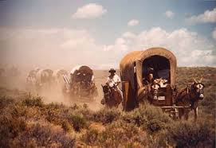
In this unit we will:
Explore the Causes and Consequences of westward expansion in the United States

Slide 4
In this unit we will:
Examine the experiences of Mexicans and Texans in the Texas Revolution

Slide 5
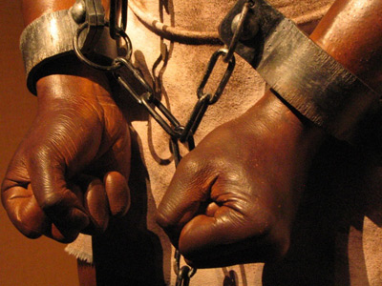
In this unit we will:
Assess the strategies regarding the debate about the expansion of slavery

Slide 6
In this unit we will:
Discuss the causes and consequences of the Mexican American War

Slide 7
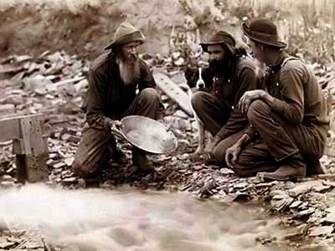
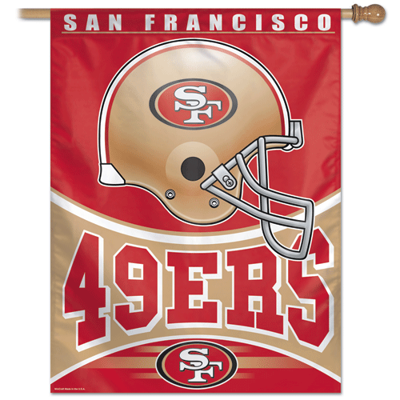
In this unit we will:
Investigate the consequences of the California Gold Rush

Slide 8
TARGET A
Examine the experiences and perspectives of significant individuals and groups during this era of American History

Slide 9
TARGET B
Use geographic terms and tolls to explain cultural diffusion throughout the United States as it expanded its territory

Slide 10
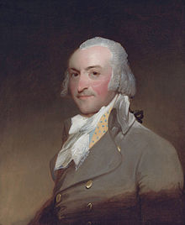
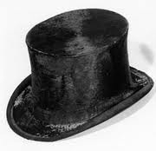
John Jacob Astor
First American Millionaire

Slide 11
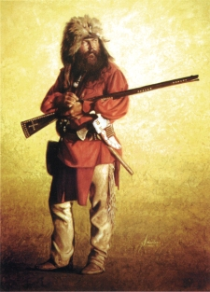
Mountain Men
Lived in the Mountains in the Northwest
Collected furs for a living

Slide 12
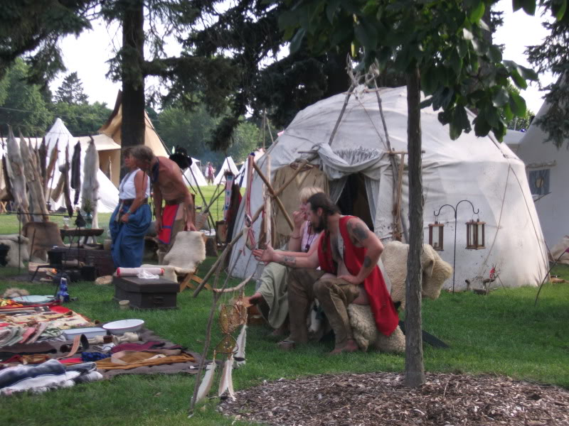
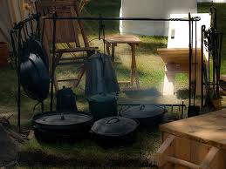
Rendevous

Slide 13
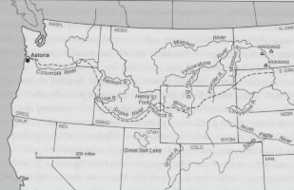
Astoria, Oregon Territory

Slide 14
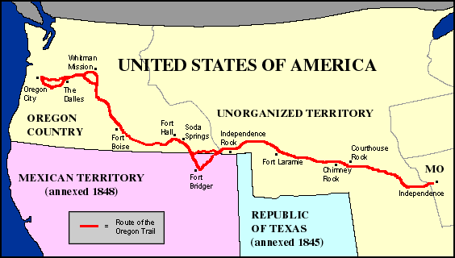
The Oregon Trail

Slide 15
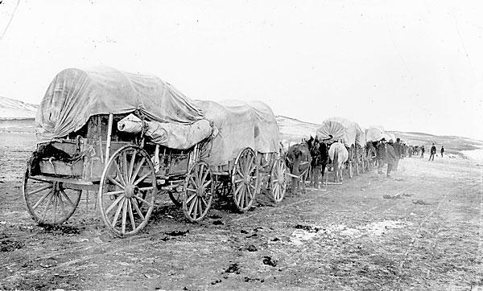
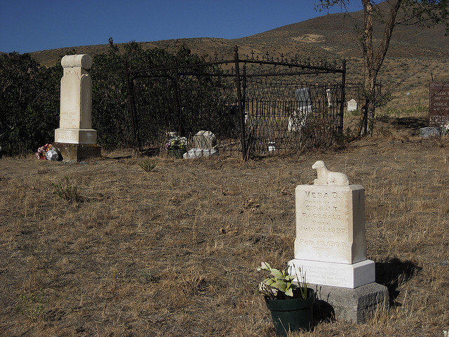
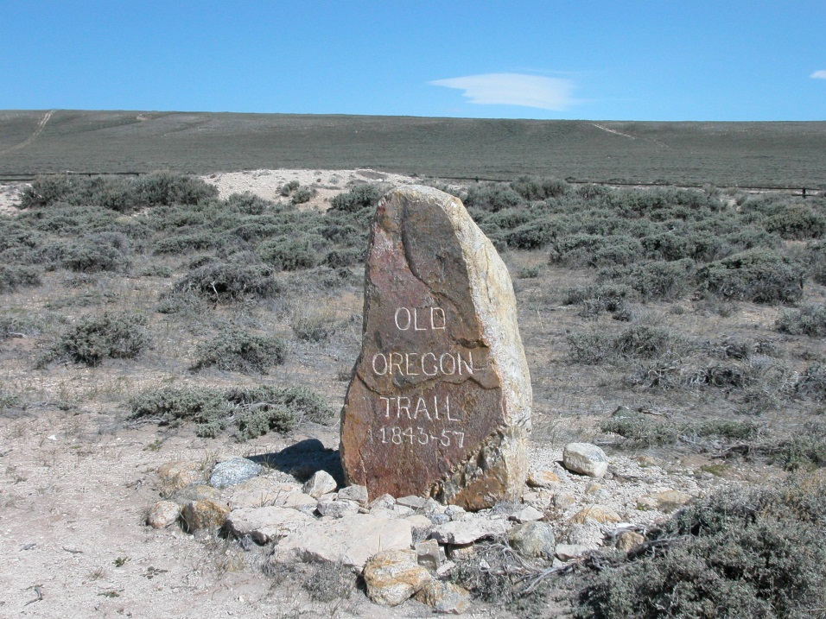
The Oregon Trail

Slide 16
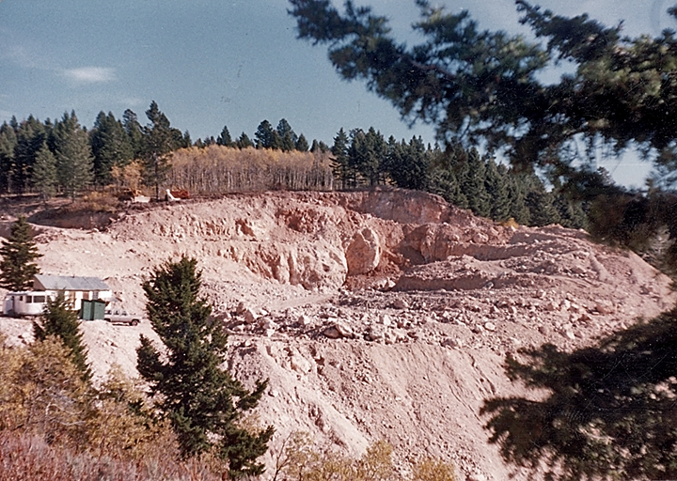
Mr. Heffron’s Oregon Trail Adventure
Opal Mining near
Spencer, Idaho

Slide 17
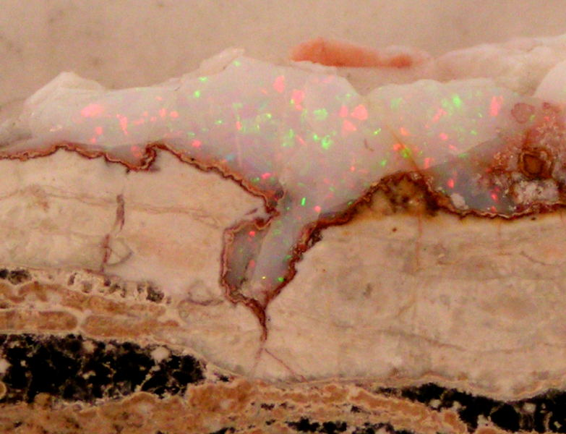
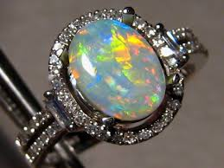
Mr. Heffron’s Oregon Trail Adventure
Opal Mining near
Spencer, Idaho

Slide 18
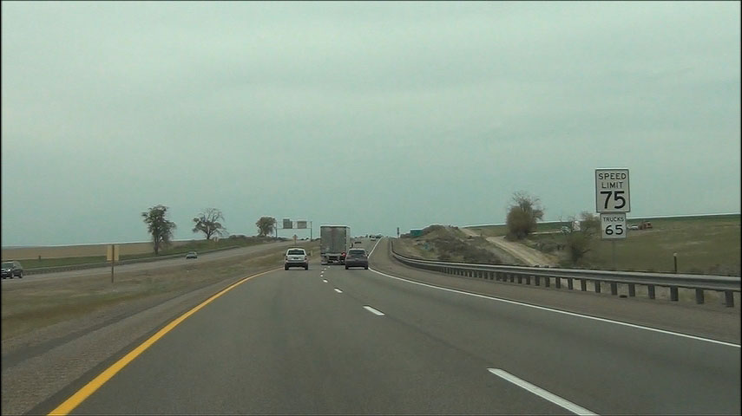
Mr. Heffron’s Oregon Trail Adventure

Slide 19
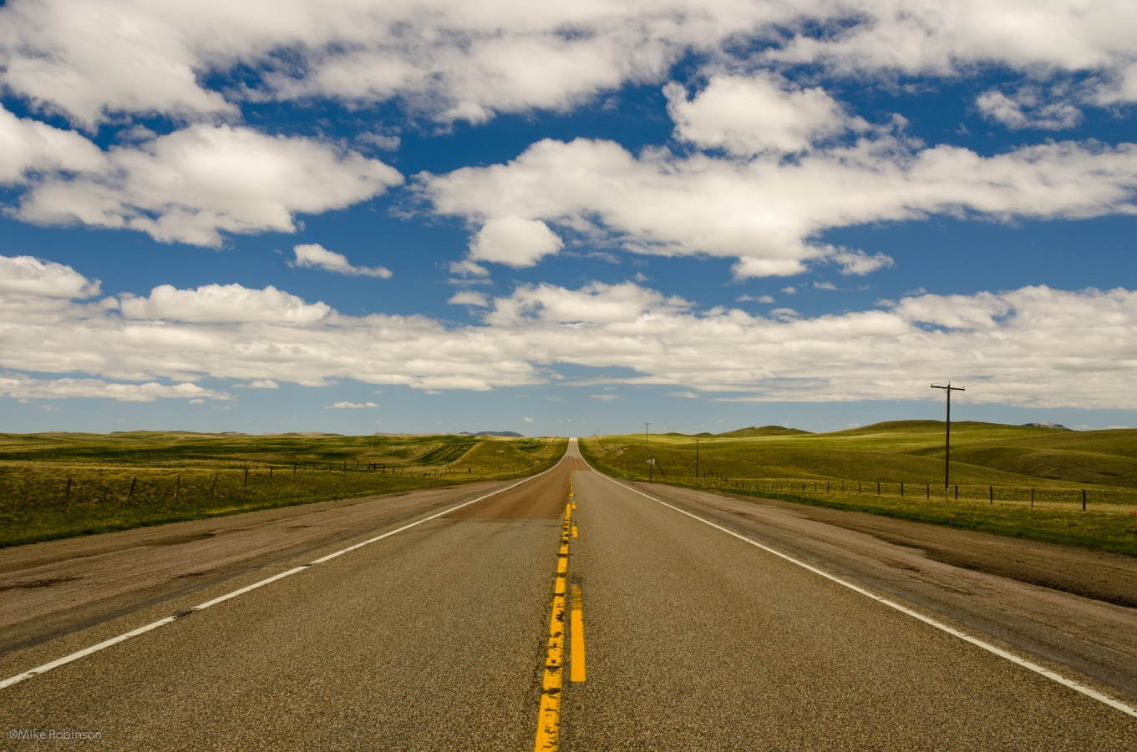
Mr. Heffron’s Oregon Trail Adventure

Slide 20
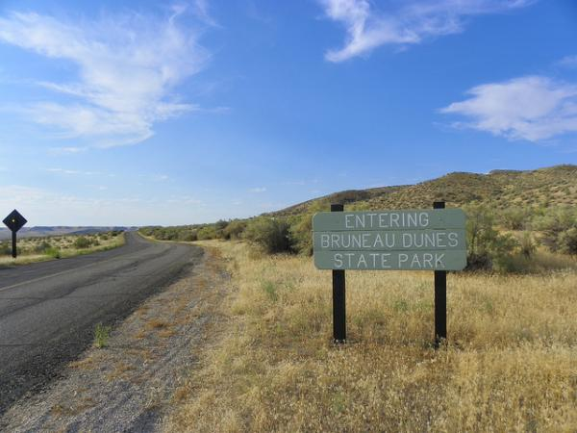
Mr. Heffron’s Oregon Trail Adventure

Slide 21
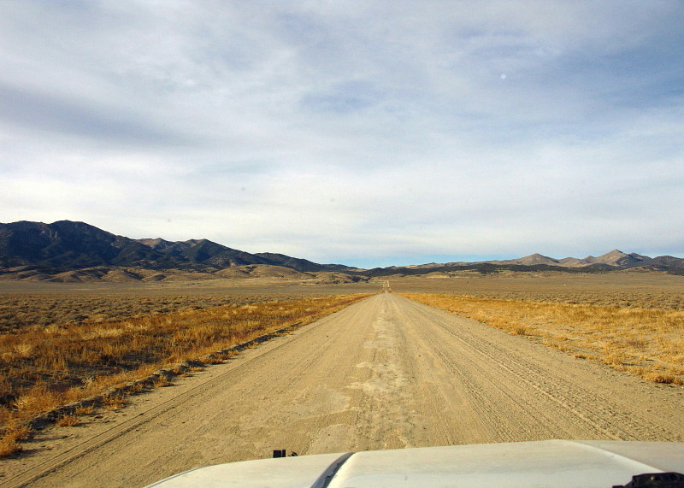
Mr. Heffron’s Oregon Trail Adventure

Slide 22
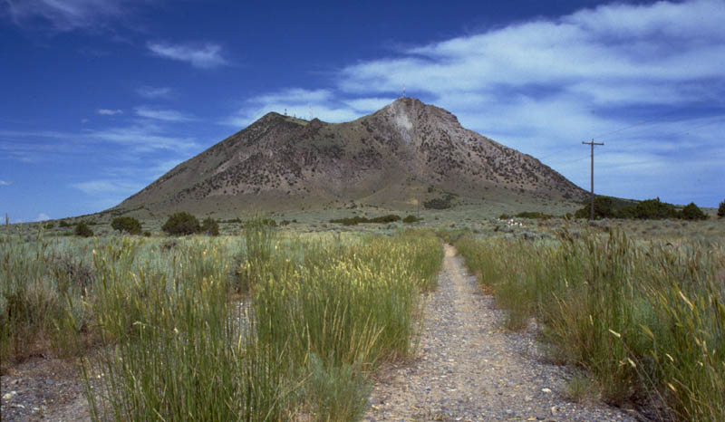
Mr. Heffron’s Oregon Trail Adventure

Slide 23
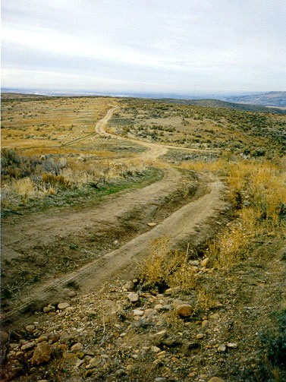
Mr. Heffron’s Oregon Trail Adventure

Slide 24
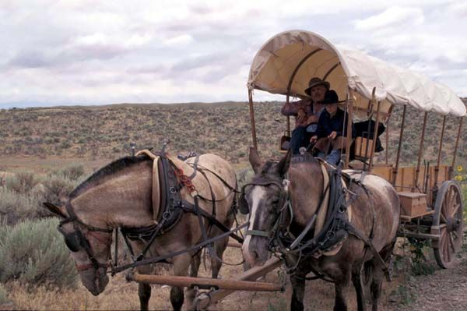
Mr. Heffron’s Oregon Trail Adventure

Slide 25
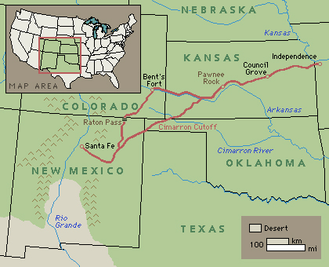
The Santa Fe Trail

Slide 26
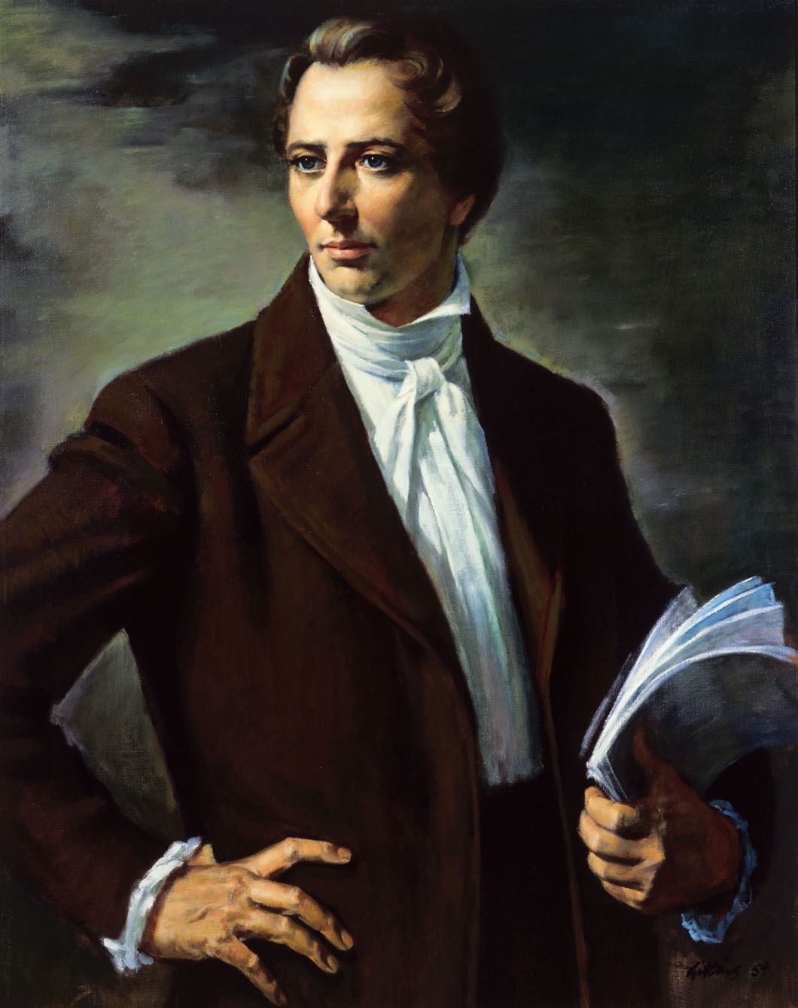
Joseph Smith
Founder of the Mormons

Slide 27
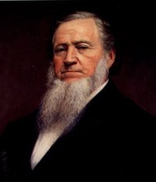
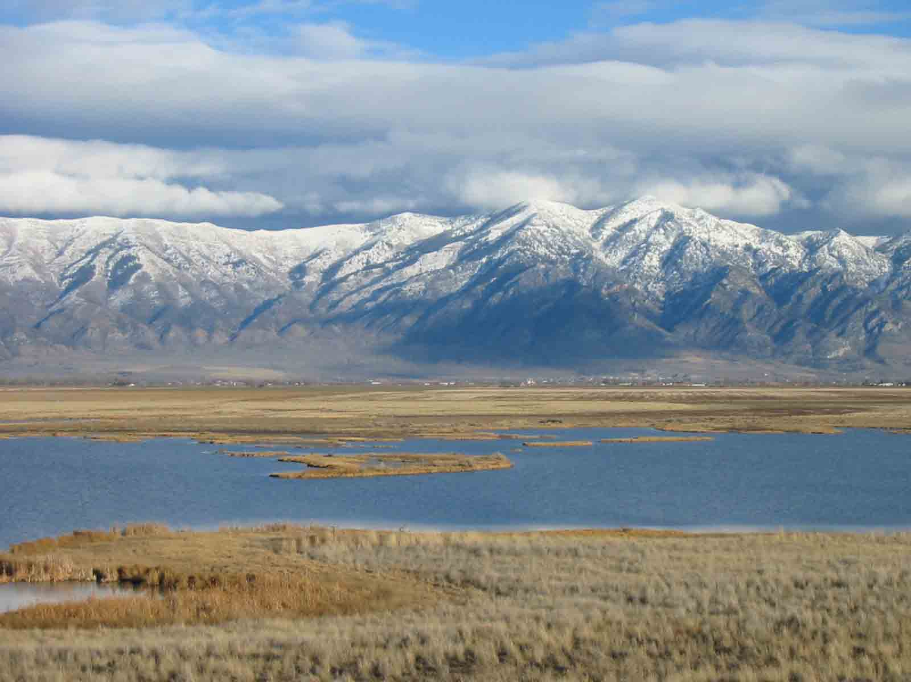
Brigham Young
Moved the Mormnons to Deseret

Slide 28
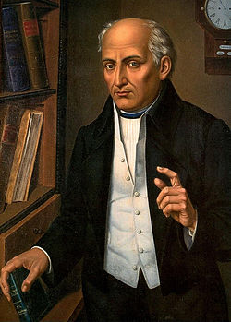
Father Miguel Hidalgo y Costilla
Gained Mexican independence from Spain

Slide 29
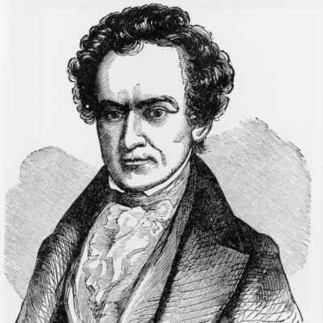
Stephen Austin
Founder of Texas

Slide 30
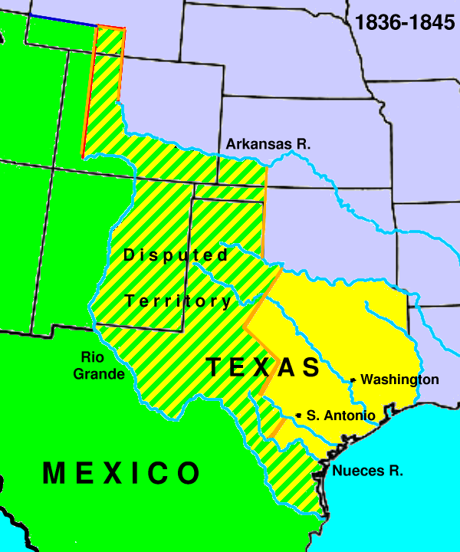
Stephen Austin’s Texas Colony

Slide 31
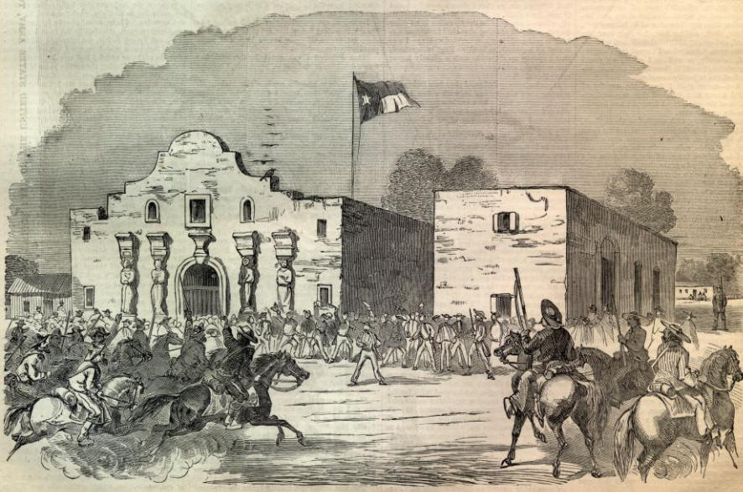
The Alamo

Slide 32
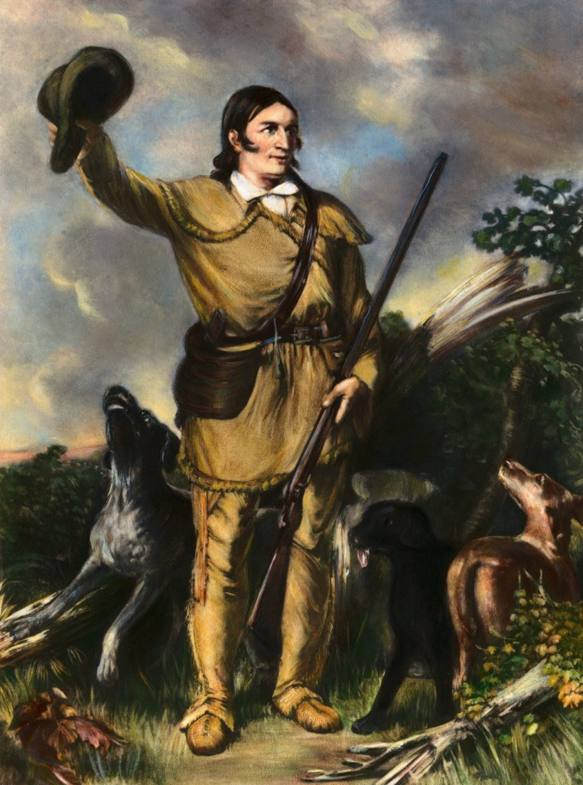
David “Davey” Crockett
Beloved American Frontiersman
Died at The Alamo

Slide 33
David Bowie

Slide 35
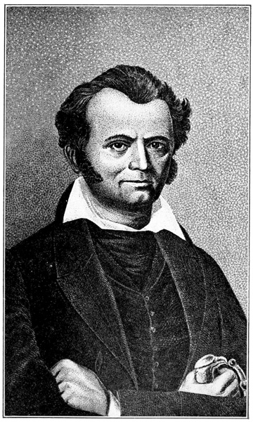
David Bowie
Inventor of the Bowie knife
Died at the Alamo
The Bowie Knife

Slide 36
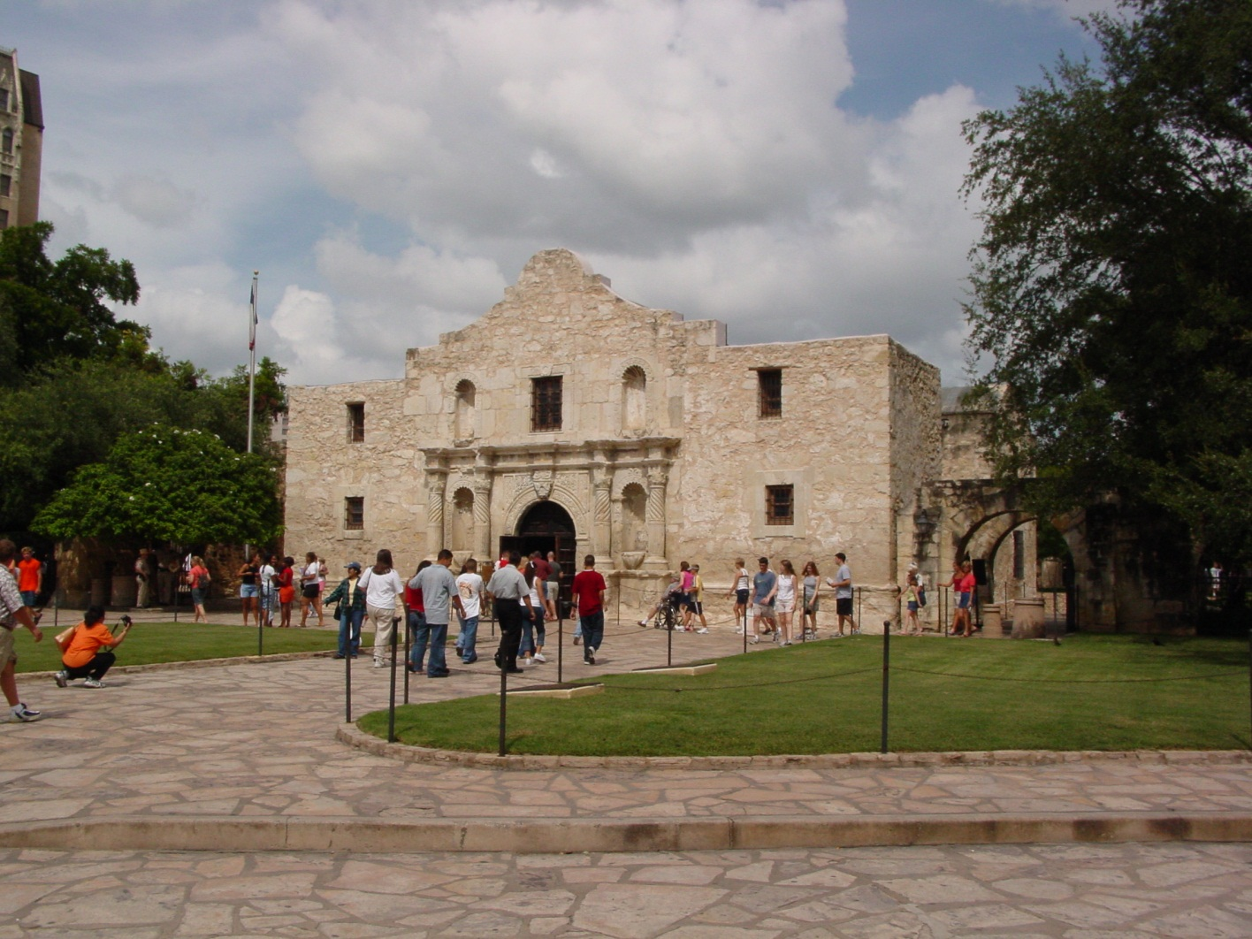
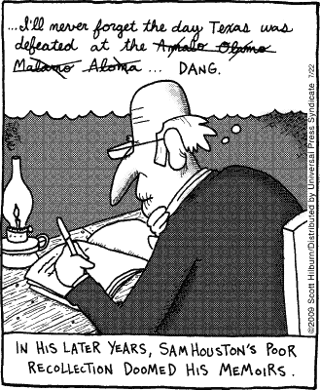
Remember the Alamo

Slide 37
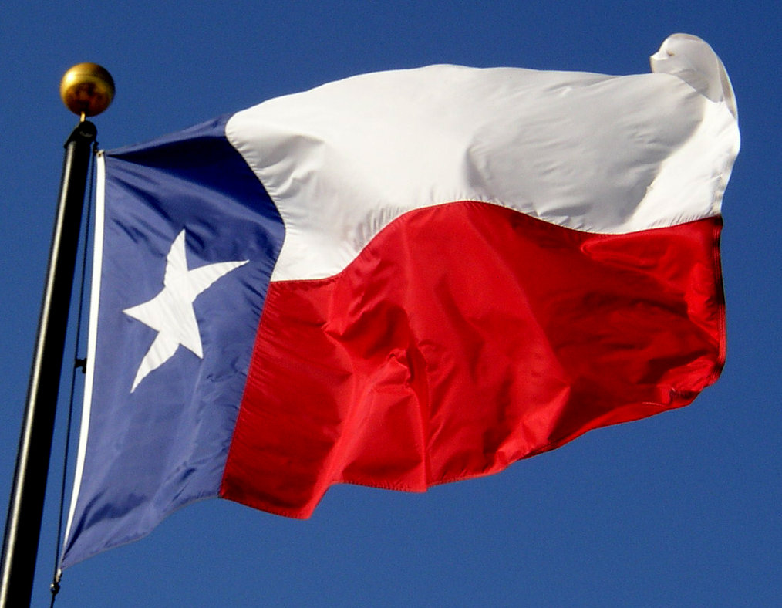
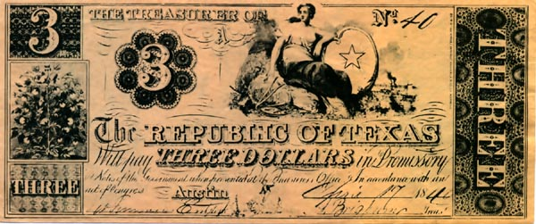

Slide 38
The Texas Rangers

Slide 39
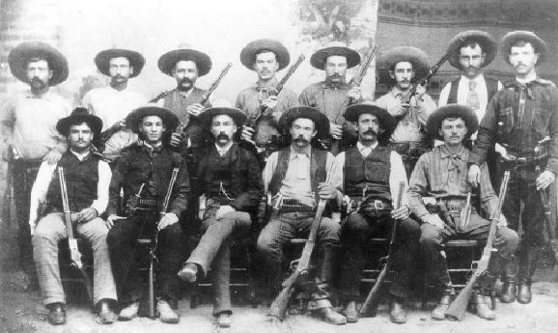
Texas Rangers (Texas Army)

Slide 40
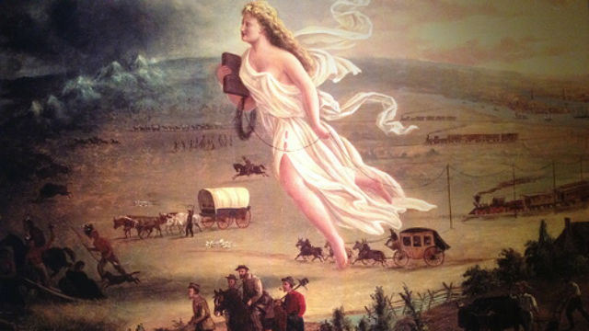
Manifest Destiny
It was “America’s manifest destiny to overspread and to possess the whole continent which Providence (God) has given us for the development of the great experiment of liberty.”

Slide 41
Population of the United States of America in:
1800 - 5,308,483
1810 - 7,239,881
1820 - 9,638,453
1830 - 12,866,020
1840 - 17,069,453
1850 - 23,191,876
1860 - 31,443,321
1870 - 38,558,371
1880 - 50,189,209

Slide 42
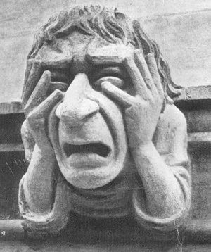
Where are You Gonna Put All Those People?

Slide 43
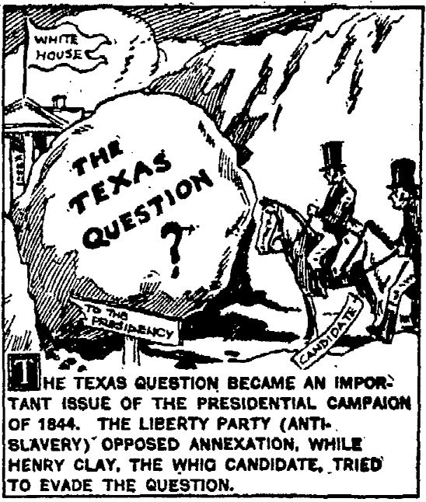
The Election of 1844

Slide 44
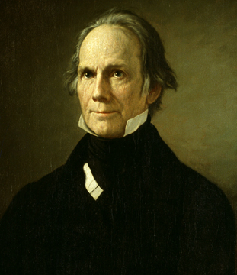
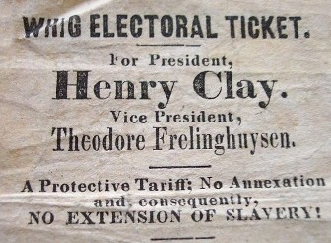
Henry Clay
Whig Party
From Kentucky
Hesitant to annex Texas

Slide 45
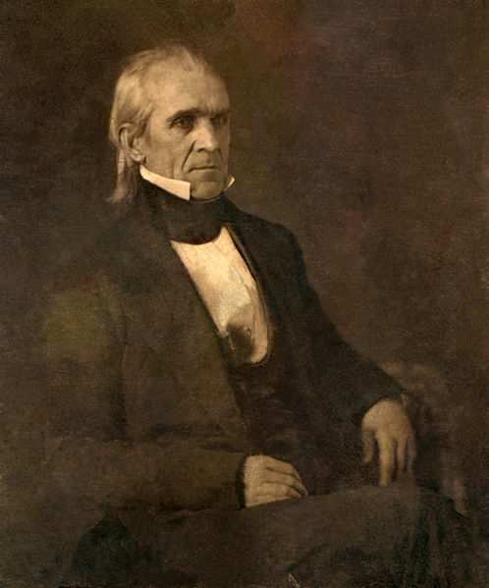
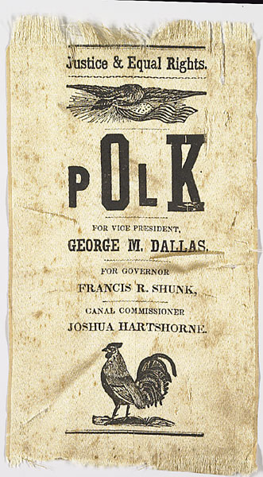
James Polk
Democratic Party
From Tennessee
Wanted to annex Texas and Oregon
Won in part because of growing British influence in Texas

Slide 47
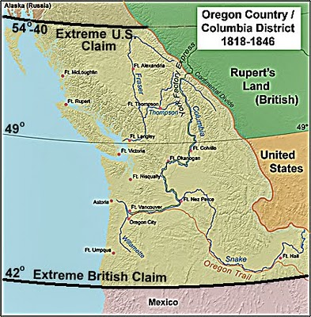

Slide 48
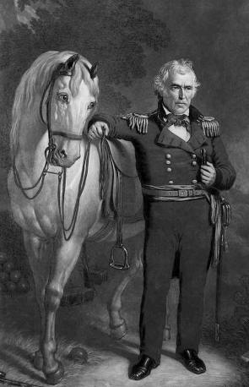
General Zachary Taylor

Slide 51
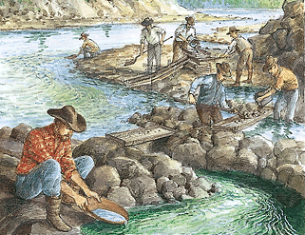
Gold Rush

Slide 52
Sutter’s Mill

Slide 53
Forty Niners

Slide 56
Case Study : Mifflin, Wisconsin
Badgers – Miners who dug into the hillsides for housing (too busy to build homes)
Largest population center in the Midwest
Mifflin Founded 1845
Population 1848 – 350

Slide 61
Most Miners left within a year this way
Some
(but very few) struck it rich

Slide 62
Gold Rush Project
• Groups of 3 assigned by Mr. Heffron
• Research 3 days in Library
• 2 days presentations in class
EACH GROUP will create a PowerPoint to include:
• Map of Sutter’s Mill
• Where did miner’s come from?
• Life in a mining camp
• Rags or riches – what are the chances of hitting the Mother Lode?
• Complete annotated bibliography
• Graphics, charts, images, cartoons
• 10 slide minimum
EACH STUDENT will also provide:
• A summary of the project – one page typed 12 pt Times New Roman font
• Describe YOUR contribution to the project and the contribution of YOUR PARTNERS

Slide 63
European Immigration:
Push Factors
Potato Blight
Religion
European
Civil Wars
Pull Factors
Land
Climate

Slide 64
Barriers
Money
Sea Travel
Source: The Irish Famine Ships Source: The Irish Famine Ships

Slide 65
Barriers
Arrival in New York
Nativism – discrimination against newcomers
Source: The Irish Famine Ships Source: The Irish Famine Ships

Slide 66
Genealogy:
The steps to creating a genealogy:
1) Write down as much as you know
2) Interview your parents – what do they know?
3) Interview the eldest members of your family, what do they remember?
4) Consult the “family genealogist”
5) Consult the internet
Assignment - create a Family Tree Genealogy:
• Research and create a Genealogy
• What ethnic groups make up your family’s past?
• Did people immigrate from oversees? When? Why?
What were their barriers? How did they overcome them?
• Create a simple family tree try for at least four generations
• Create a biography for each of your four familial lines (a family history)
• Genealogy is due in 2 weeks
100 point project grade
Include a one page summary of your genealogical hunt (what did you discover, what difficulties did you encounter, how long did it take you to find the information you have?
Your grade will be determined on the effort you demonstrate in your summary

