Slide 1
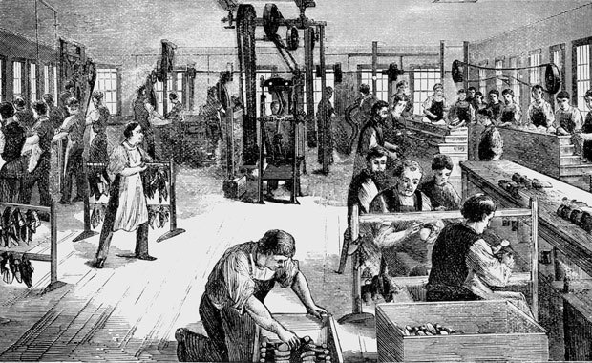
Unit Seven Industrialization

Slide 2
Unit Essential Question
How did technological advancements impact economic and social development in the U.S.A.?

Slide 3
Unit Learning Goal
Technological advancements accelerated economic and social developments in the U.S.A.?

Slide 4
Target A
Identify inventions and inventors that contributed to industrial growth.

Slide 5
Target B
Explain the causes and consequences of the transportation revolution.

Slide 6
Industrial Revolution
Period of rapid growth in the use of machines in manufacturing.

Slide 7
Textiles
Cloth

Slide 8
Trade Unions
Worker’s organizations that try to improve working conditions.

Slide 9
Telegraph
Machine invented by Samuel Morse which uses electrical pulses to send messages over long distances.

Slide 10
Lowell System
The use of water-powered textile mills that employed unmarried women as laborers.

Slide 11
Cotton Gin
Machine invented by Eli Whitney in 1793 used to remove seeds from cotton plants and revolutionized the cotton industry.

Slide 12
Folk Tales
A story that provides a moral lesson.

Slide 13
Spirituals
Emotional Christian songs sung by slaves.

Slide 14
Transportation Revolution
The rapid growth of in the speed and convenience of transportation.

Slide 15
Interchangeable Parts
Process invented by Eli Whitney that called for manufacturing identical parts.

Slide 16
Inventions

Slide 17
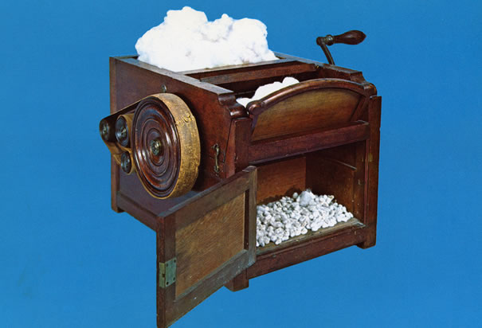
The Cotton Gin

Slide 18
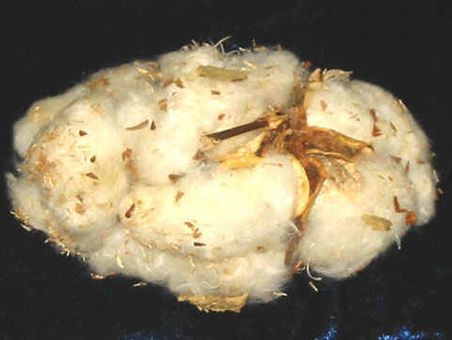

Slide 19
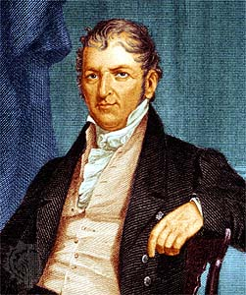
Eli Whitney
Inventor of the Cotton Gin

Slide 20
Cotton Gin
Strip cotton seeds from picked cotton saved hundreds of man hours per pound

Slide 21
Cotton Gin
Strip cotton seeds from picked cotton saved hundreds of man hours per pound
“Gin” is slang for “Engine” even though it is human powered.

Slide 22
Cotton Gin
Strip cotton seeds from picked cotton saved hundreds of man hours per pound
“Gin” is slang for “Engine” even though it is human powered.
Important because of the huge demand for cotton by textile manufacturers in Great Britain.

Slide 23
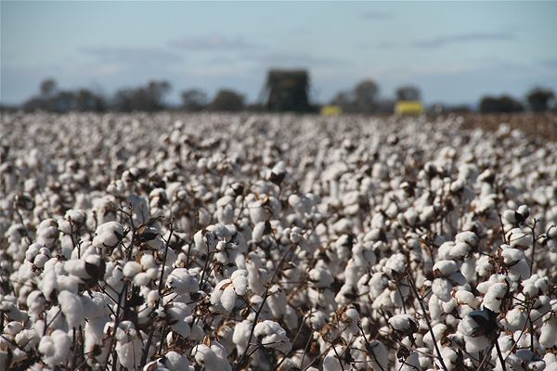
Cotton Boom

Slide 24
Cotton Boom
Cotton Gin makes cotton fabulously valuable

Slide 25
Cotton Boom
Cotton Gin makes cotton fabulously valuable
1810 : 100,000 bales produced nationwide
1850 : 2,200,000 bales produced nationwide

Slide 26
Cotton Boom
Cotton Gin makes cotton fabulously valuable
1810 : 100,000 bales produced nationwide
1850 : 2,200,000 bales produced nationwide
Spurred the growth of southern cities:
Charleston, SC
New Orleans, LA
Savanah, GA

Slide 27
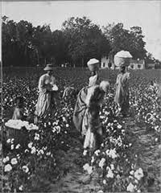
Cotton Boom
Created a HUGE DEMAND
for slave labor

Slide 29
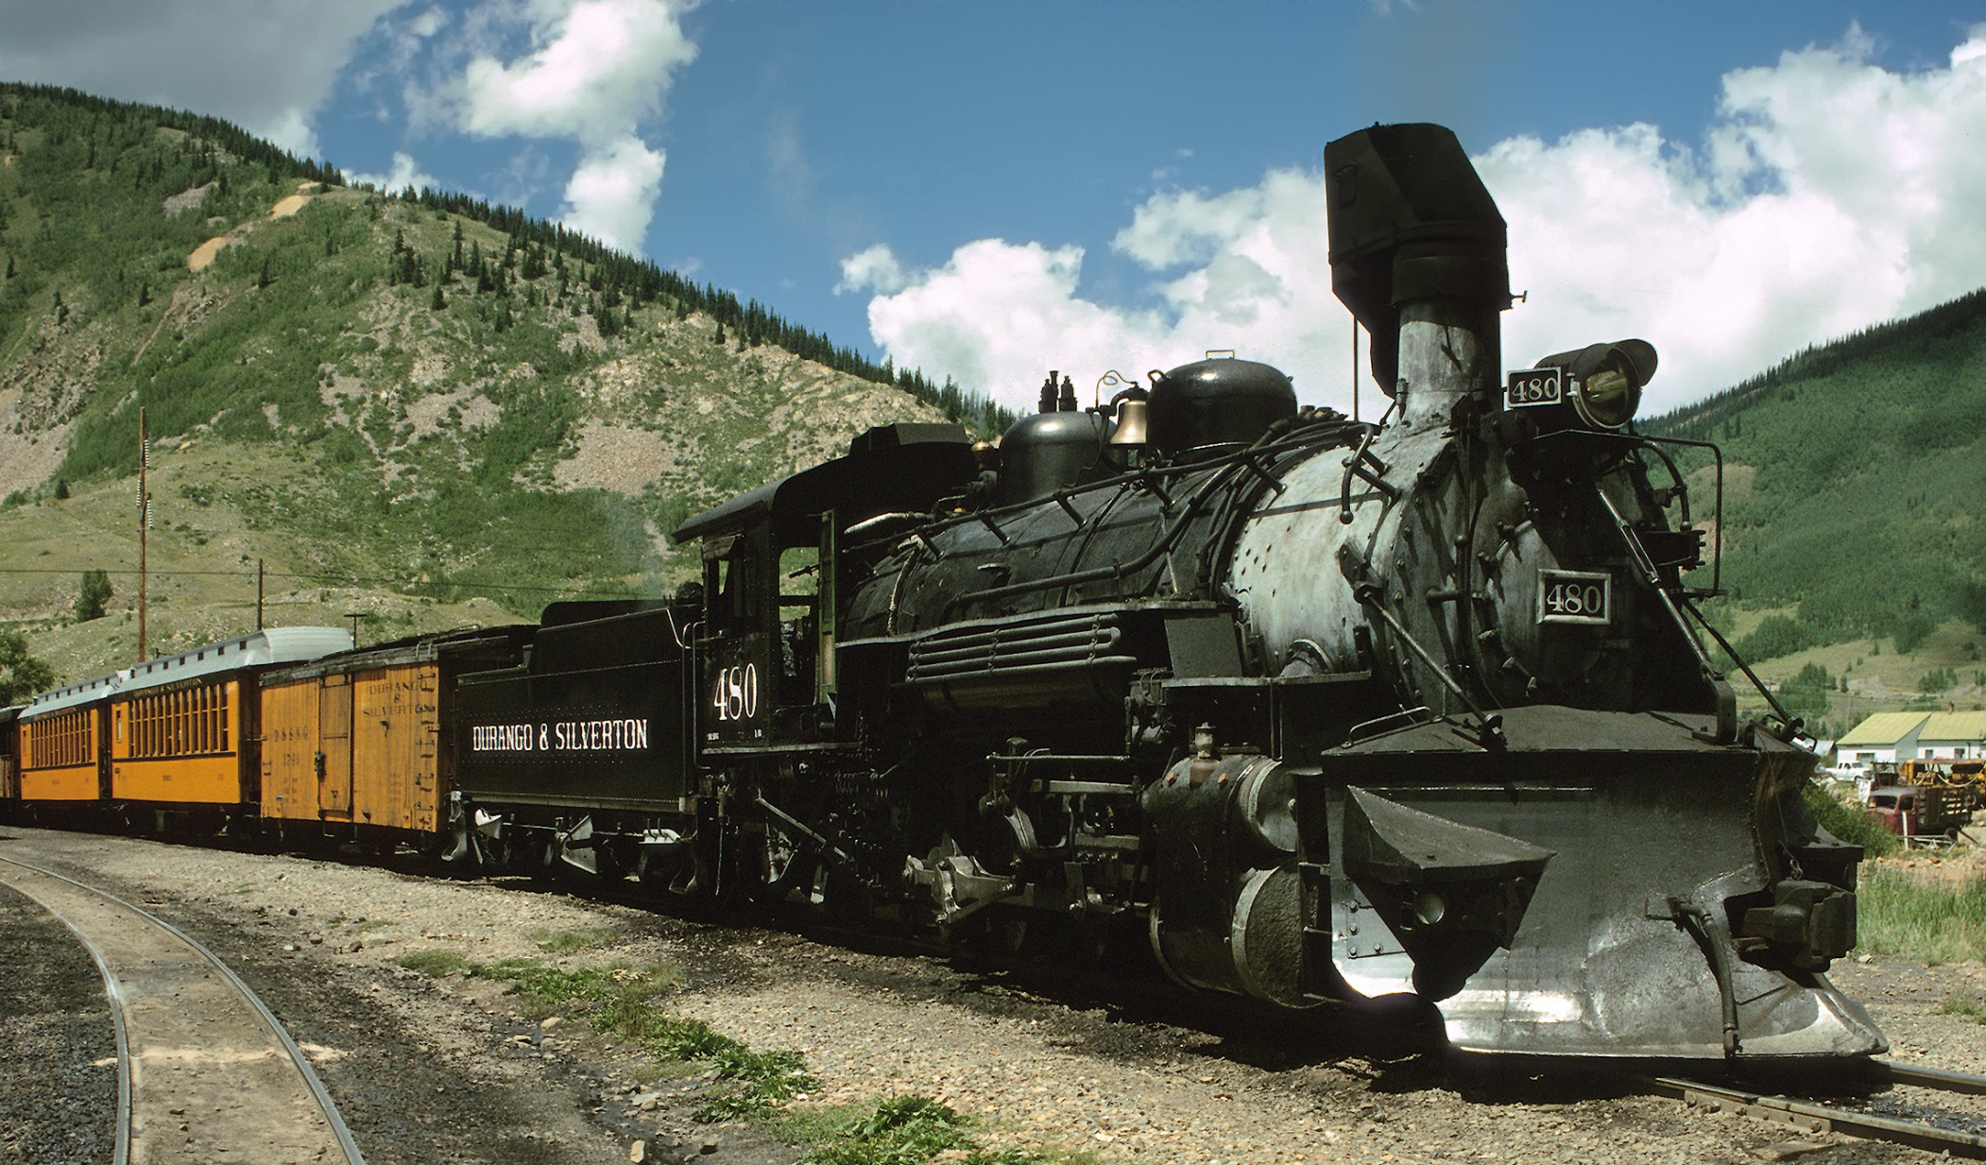
The Railroad

Slide 30
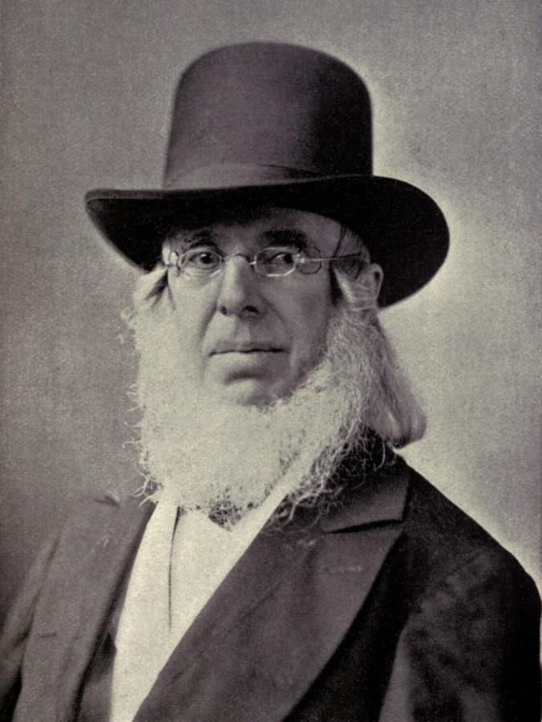
Peter Cooper
Inventor of the Tom Thumb steam locomotive in 1830

Slide 31
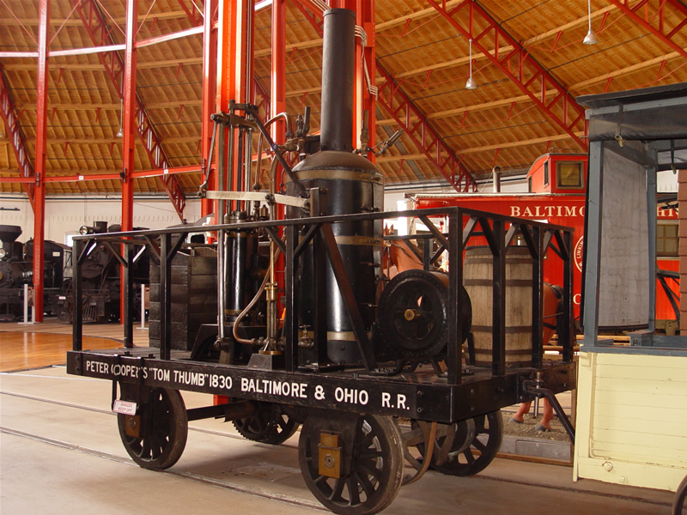

Slide 32
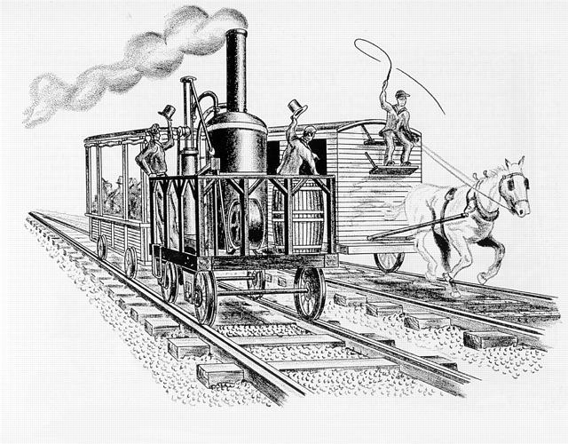

Slide 33
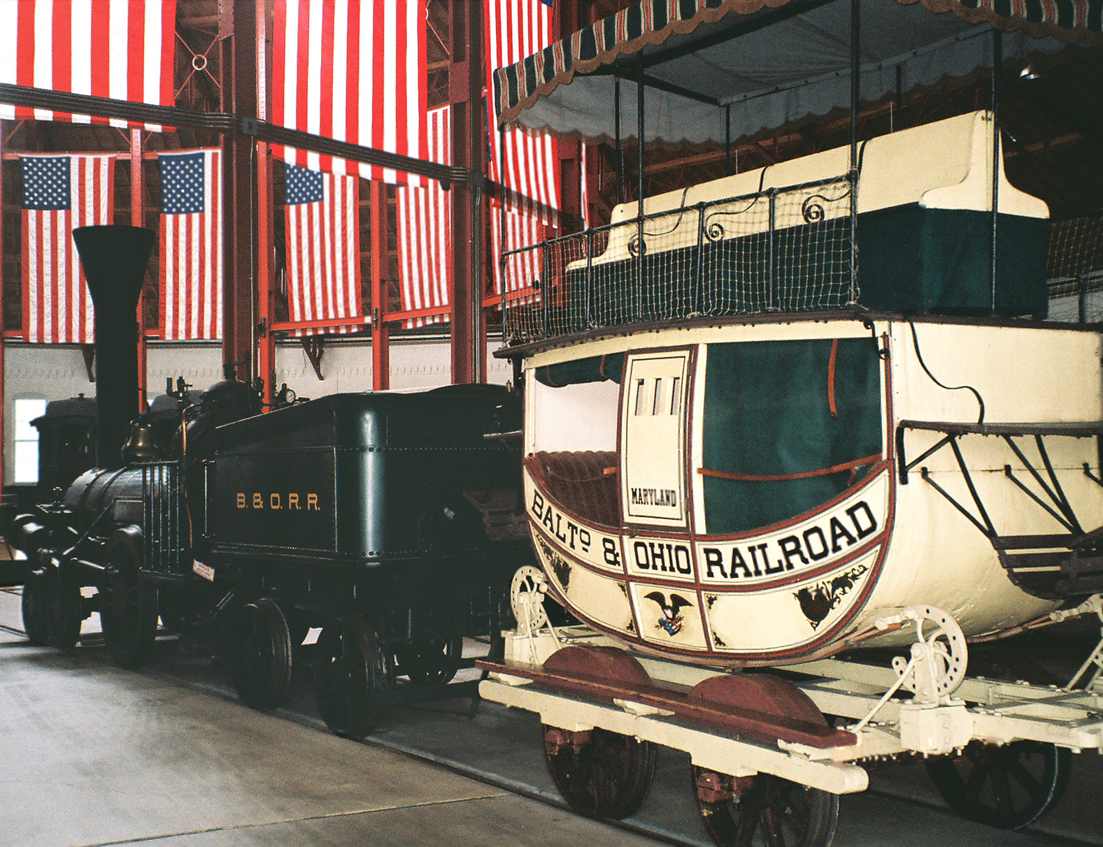
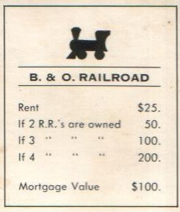

Slide 34
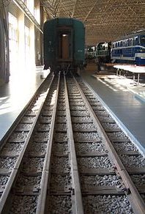
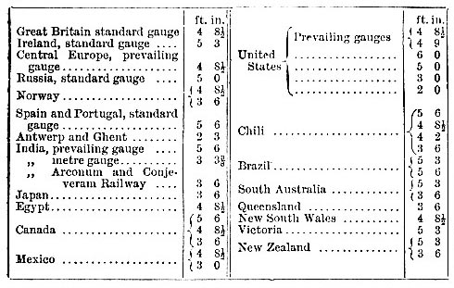
Railroad Gauges

Slide 35
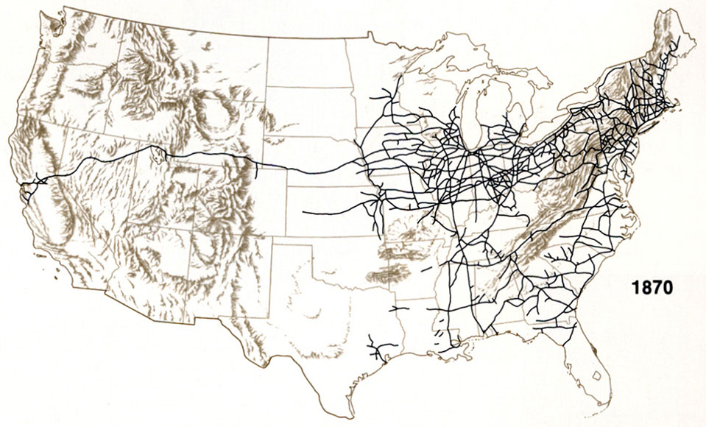
Growth of the Railroad Industry

Slide 37
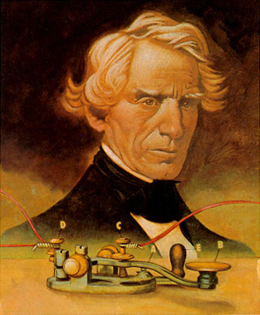
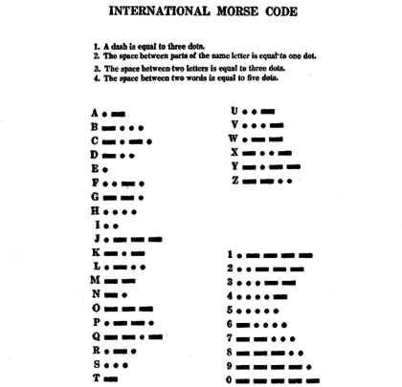
Samuel Morse
Instant Communication

Slide 38
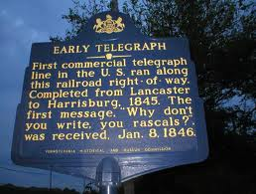

Slide 39
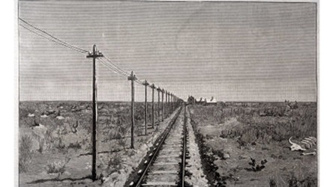

Slide 40
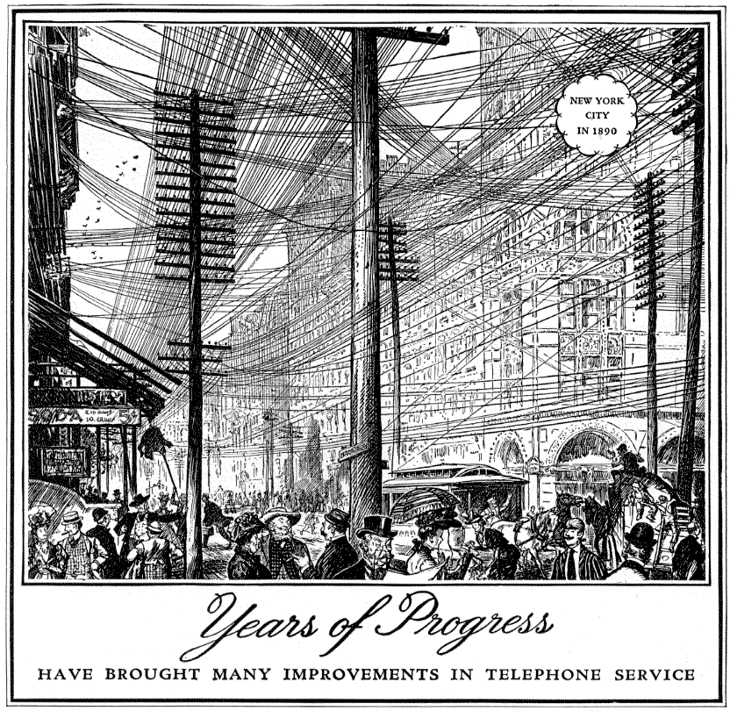
Progress?

Slide 41
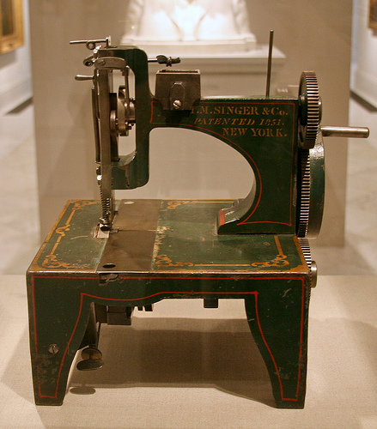
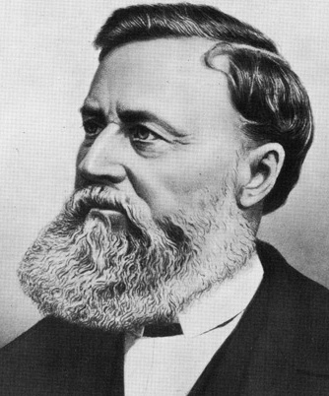
Isaac
Singer
Made the Textile Industry possible

Slide 42
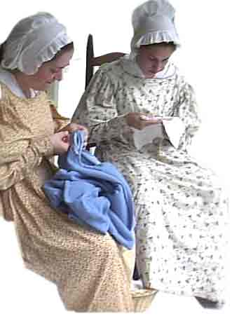
The Textile Industry in 1850

Slide 43
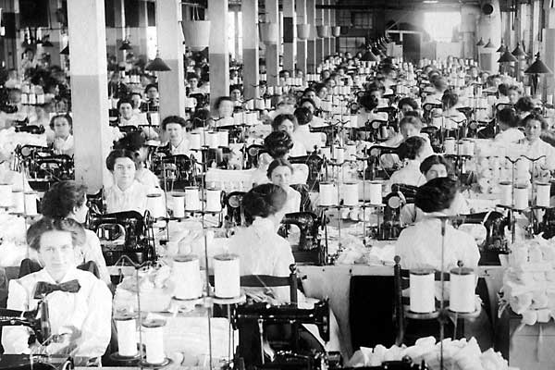
Textile industry after 1851 thanks to the sewing machine

Slide 44
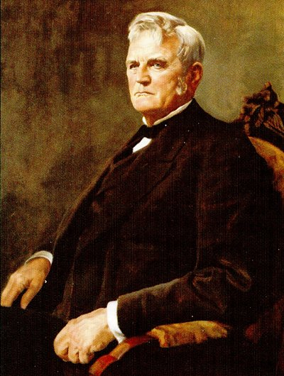
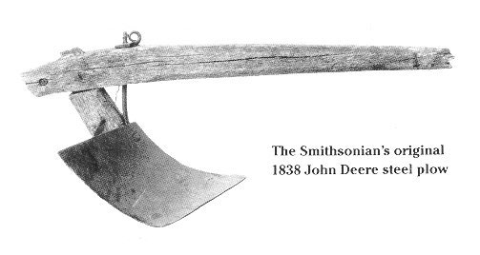
John Deere
The Steel Plow allowed farmers to open the Great Plains to cultivation

Slide 45
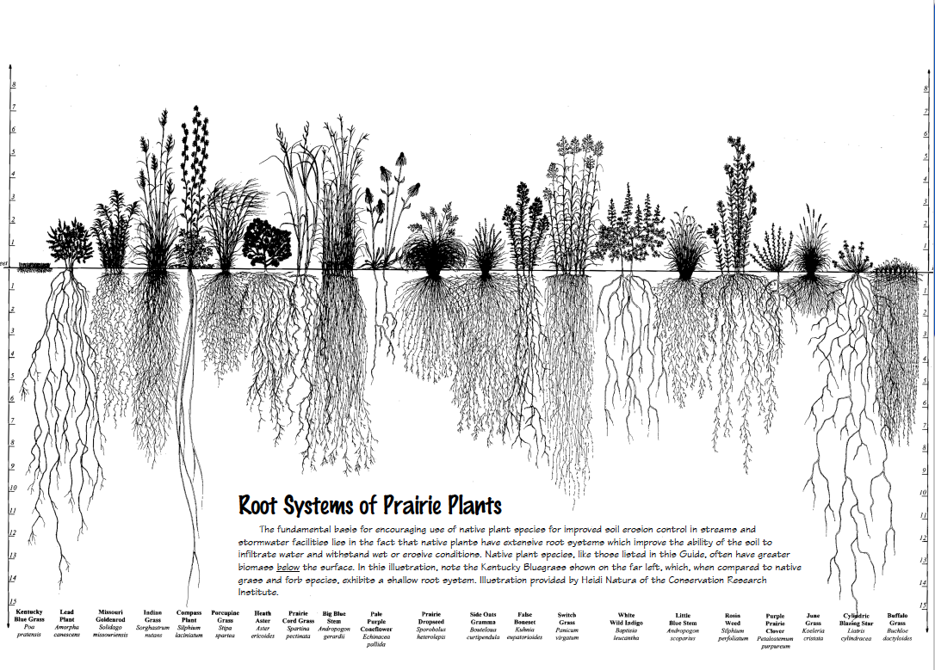

Slide 46
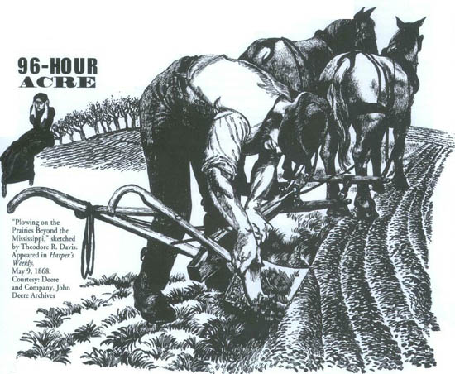

Slide 48
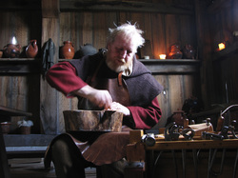
The Cobbler

Slide 49
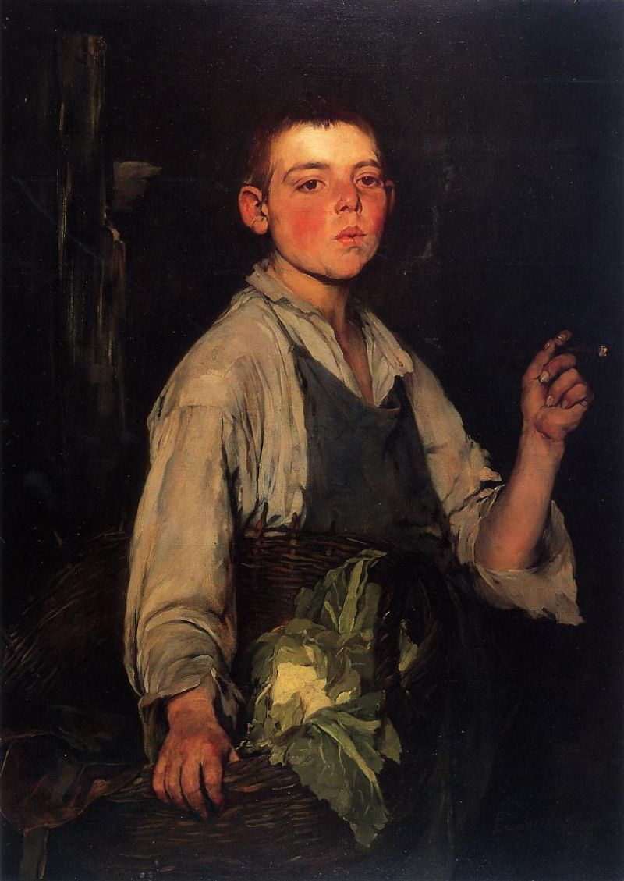
Poor little Mikey is orphaned, broke, homeless, needs a helping hand

Slide 50
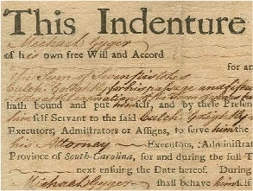

Slide 51
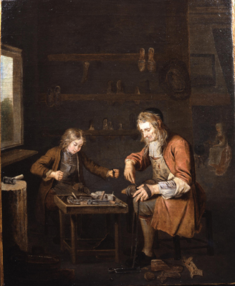
Through the Indentured Servant System, The cobbler is happy because he now has help. Little Mikey is happy because he has a home, food and is learning a job.

Slide 52
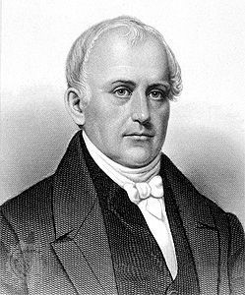
Samuel Slater
Father of the Industrial Revolution

Slide 53
Samuel Slater
Memorized British textile machine designs and came to America
Slater the Traitor

Slide 54
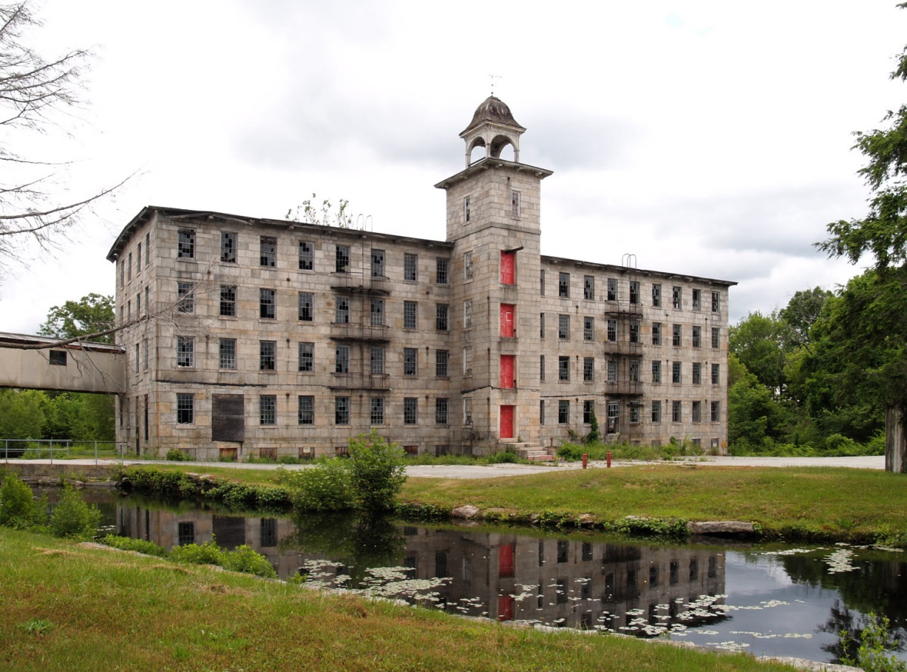
The Rhode Island System
Developed by Samuel Slater

Slide 55
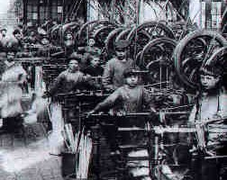
The Rhode Island System
Developed by Samuel Slater
Employed entire families

Slide 56
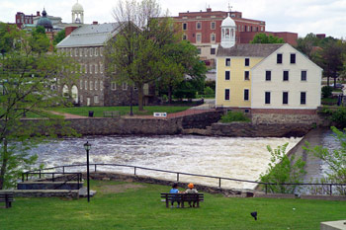
The Rhode Island System
Developed by Samuel Slater
Employed entire families
Developed the first “Company Town”

Slide 57
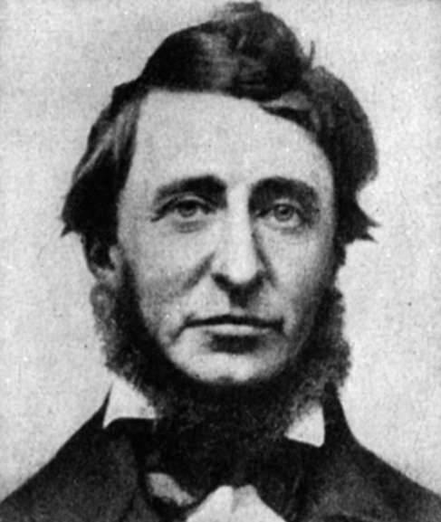
Francis Cabot Lowell

Slide 58
Francis Cabot Lowell
Created The Lowell System

Slide 59
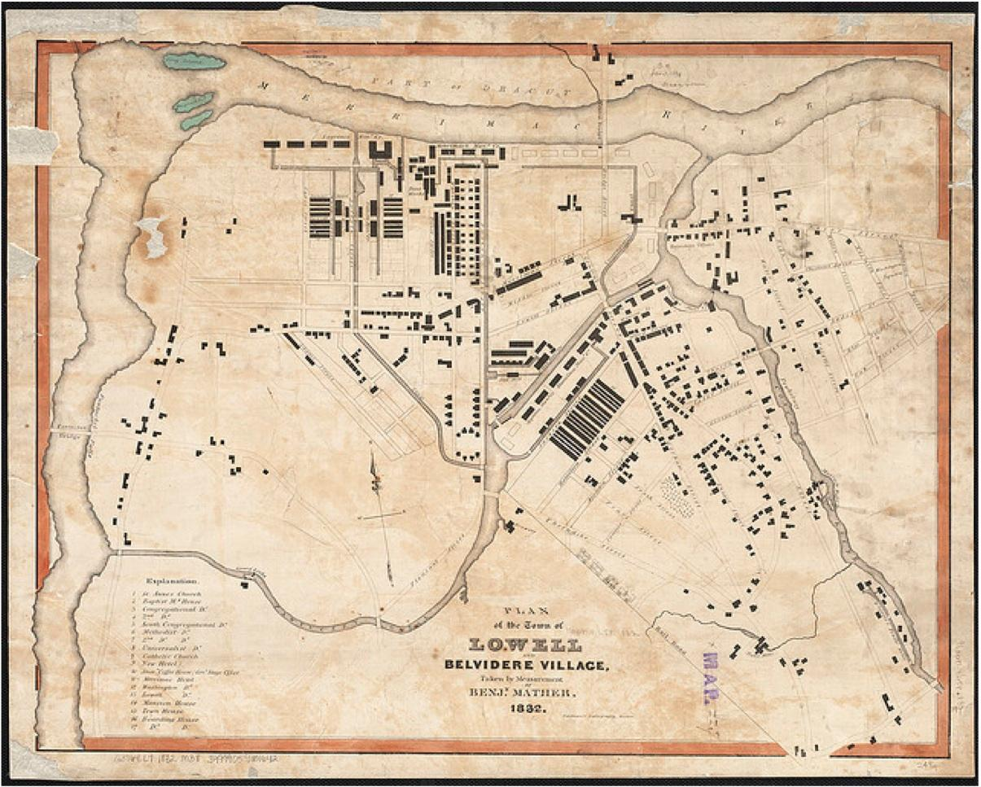

Slide 60
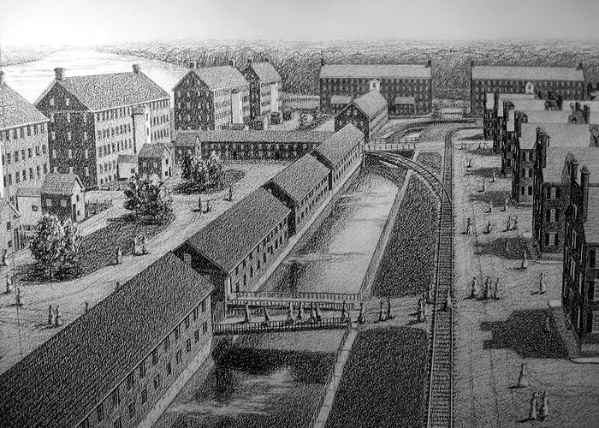
Francis Cabot Lowell
Created The Lowell System
Lowell, MA

Slide 61
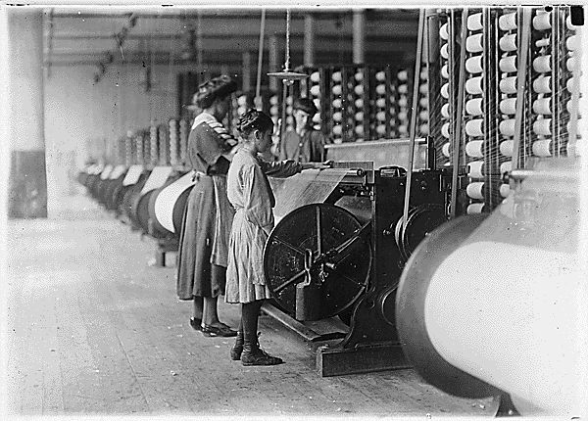
Francis Cabot Lowell
Created The Lowell System
Lowell, MA
Female Labor

Slide 62
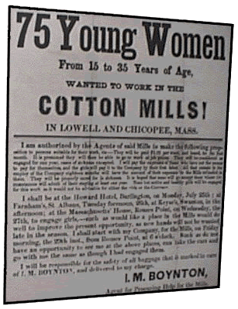
Francis Cabot Lowell
Created The Lowell System
Lowell, MA
Female Labor
Gave Women Independence

Slide 63
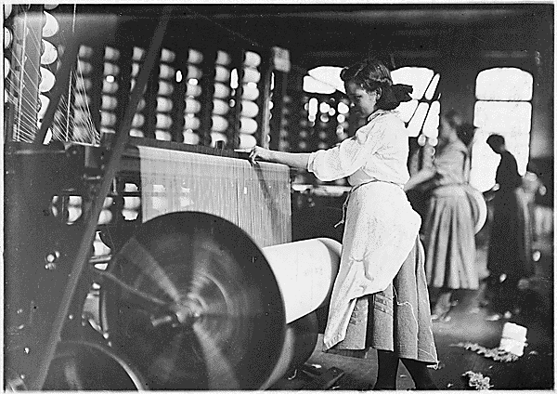
Problems with the Lowell System
Dangerous work

Slide 64
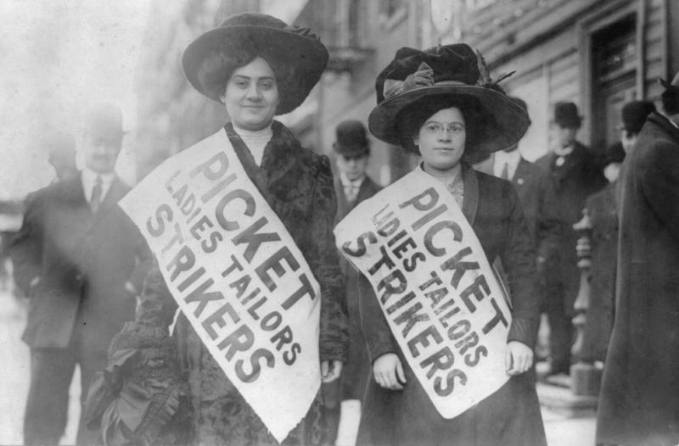
Problems with the Lowell System
Dangerous work
Workers Unite

Slide 65
Problems with the Lowell System
Lowell Girls’ wages: $ 2.54 / WEEK
Average men’s wages: $1.50 / DAY

Slide 66
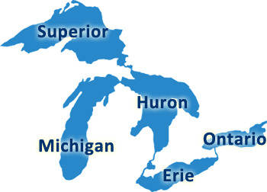
Evolution of The Great Lakes Region

Slide 67
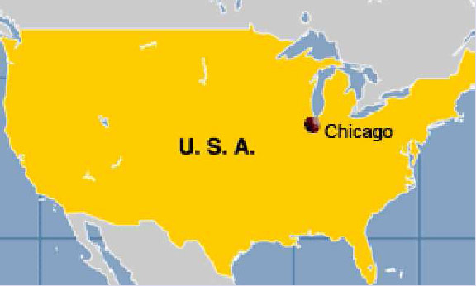
Chicago, Illinois

Slide 68
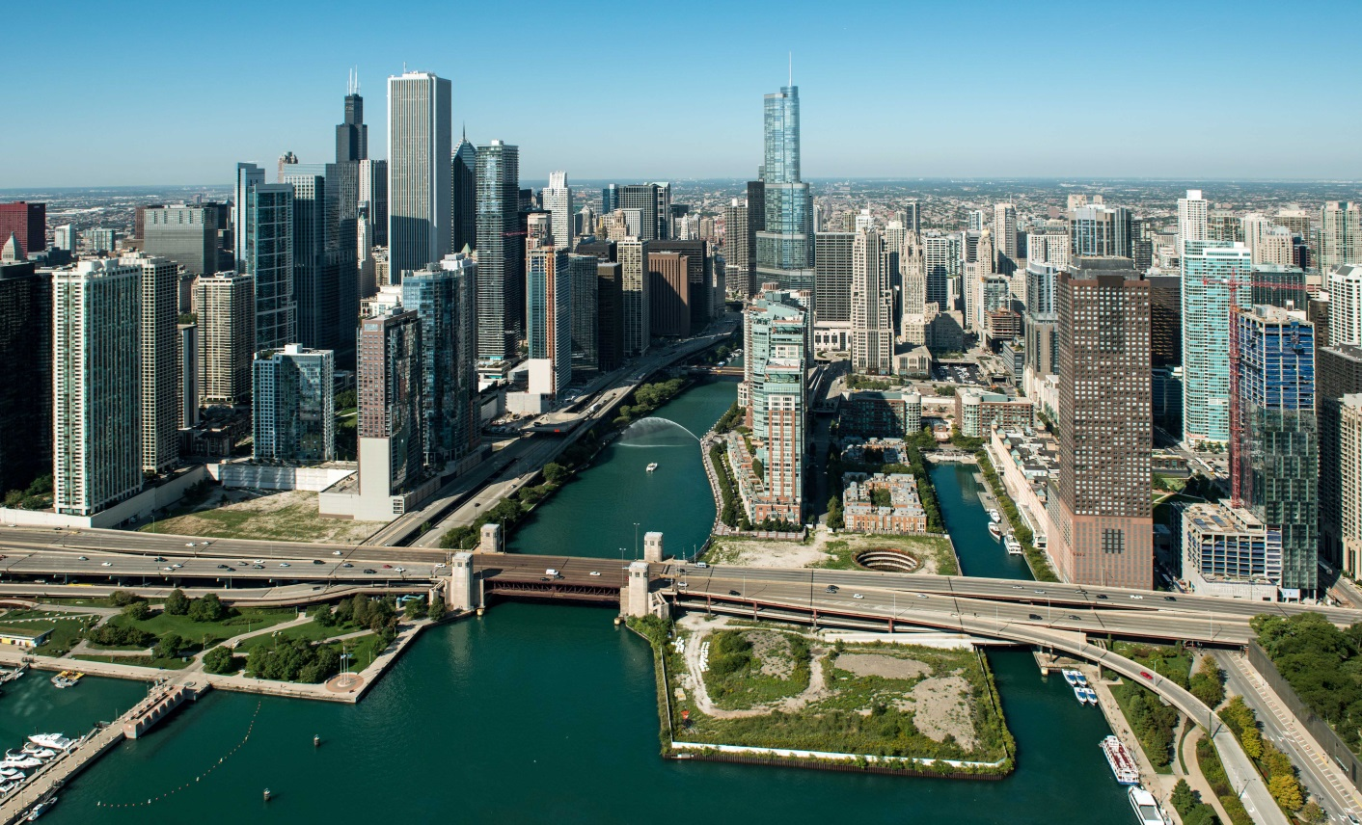
Chicago, Illinois
Illinois River connected to Lake Michigan via canal

Slide 69
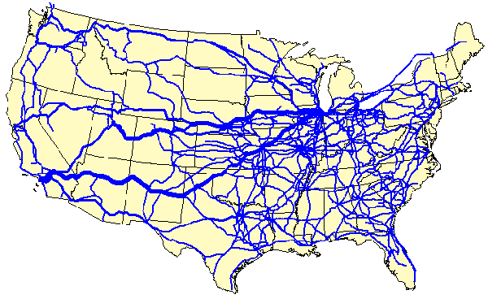
Chicago, Illinois
Railroad hub of North America

Slide 70
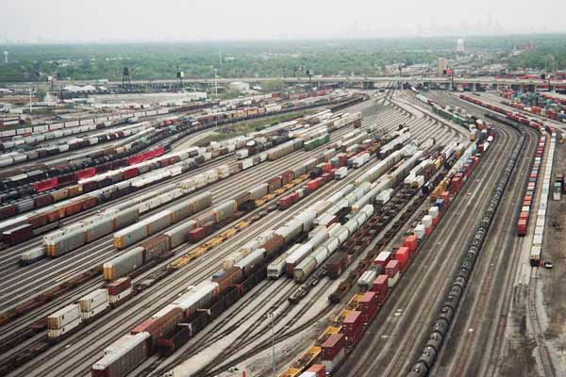
Chicago, Illinois
Railroad hub of North America

Slide 71
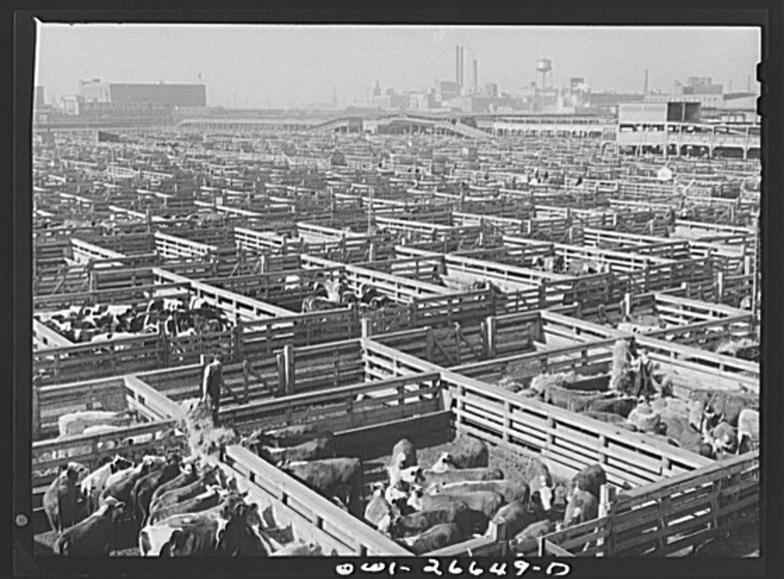
Chicago, Illinois
Chicago Stockyards provide efficient shipping of fresh meat to the country

Slide 72
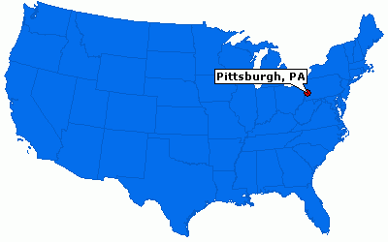
Pittsburg, Pennsylvania

Slide 73
Andrew Carnegie

Slide 74
Iron Range Northern Minnesota

Slide 75
Coal Mine in Pennsylvania

Slide 76
Steel Production

Slide 77
Consequences of Steel Production
Growth of urban cities

Slide 78
Consequences of Steel Production
Growth of urban cities
Creation of the Skyscraper

Slide 79
Why is this not happening in the South?
It’s too hot (no air conditioning yet)

Slide 80
Why is this not happening in the South?
It’s too hot (no air conditioning yet)
Not a good location

Slide 81
Why is this not happening in the South?
It’s too hot (no air conditioning yet)
Not a good location
Different way of life was developing

Slide 83
Antebellum: Pre-Civil War Era

Slide 84
Antebellum Life

Slide 85
Antebellum Life

Slide 90
Oak Alley Plantation

Slide 91
Gone With the Wind 2:42
http://www.youtube.com/watch?v=2zomyWfPgjE
Went with the wind
http://www.youtube.com/watch?v=pjUYw2HKB7o

Slide 92
The Dark Side of Antebellum America
The success of Antebellum society is fueled by slave labor

Slide 94
Abe Lincoln’s first home in New Salem, Illinois

Slide 95
Slave Gang

Slide 96
The Overseer

Slide 97
Yeoman Farmers
Owner of a small farm
0-2 slaves
Worked alongside his slave
100acre size farm – average size

Slide 98
Yeoman Farmers
Owner of a small farm
0-2 slaves
Worked alongside his slave
100acre size farm – average size
Cost of a slave in today’s money $ 35,000

Slide 100
Southern Religion and Society
Plantations were like small communities and were really spread out with vast distances between them.
Relied on social activities, such as the Antebellum Ball, as social gatherings

Slide 101
Southern Religion and Society
Big Plantation = Money

Slide 102
Southern Religion and Society
Big Plantation = Money
Money = Power

Slide 103
Southern Religion and Society
Big Plantation = Money
Money = Power
Power = Make the Laws

Slide 104
Southern Religion and Society
Big Plantation = Money
Money = Power
Power = Make the Laws
Make the Laws = Keep / make more money and power

Slide 105
Southern Religion and Society
All of this because they convinced themselves that God intended for whites to rule over blacks

Slide 106
Life as a Slave
PLANTATION SLAVE
Worked on a Slave Gang
Worked from “Can See” to “Can’t See”

Slide 107
Life as a Slave
House Slave
Better working conditions
Generally better treatment

Slide 108
Life as a Slave
Playmates
Not many white children around to play with)

Slide 109
Life as a Slave
Driver
Slave you could trust to go to town

Slide 110
Life as a Slave
Mammy
Babysitter
Wet Nurse

Slide 111
Life as a Slave
Flogging
Runaway slaves
Disobeying your Master

Slide 113
Consequences of Antebellum Slave Life
Slaves became incredibly valuable
Families torn apart

Slide 114
Consequences of Antebellum Slave Life
Slaves Adapt to changing conditions of family life

Slide 115
Uncle Remus

Slide 117
Slave Life
Brother Substitute for a male relative
Sister Substitute for a female relative
Uncle Wise elderly male slave
Aunt Wise elderly female slave

Slide 118
Slave Religion
Closely monitored
Spirituals: songs which combined Christianity and African values

Slide 119
Slave Religion
Closely monitored
Spirituals: songs which combined Christianity and African values
CLOSELY MONITORED

Slide 120
Slave Uprisings
Always feared
Seldom Occurred

Slide 121
Nat Turner
Responsible for the most violent slave uprising in US history
1831 Virginia
Wanted to kill all slave owners in the county

Slide 122
Nat Turner
60 whites killed
100 innocent slaves killed in search for Turner
Turner executed
Resulted in even stricter slave laws

