Slide 1
UNIT FOUR The Early Years
Unit Essential Question
How did government policies in the early years form the foundation of the new nation?

Slide 2
Target One The Washington Administration Target Two The Adams Administration Target Three The Jefferson Administration Target Four The Madison and Monroe Administrations

Slide 3
Vocabulary
Electoral College
A group of people selected from each of the states to cast votes in presidential elections

Slide 4
Vocabulary
Bank of the United States
A national bank chartered by Congress in 1791 to provide security for the US economy

Slide 5
Vocabulary
French Revolution
French rebellion that began in 1789 in which the French people overthrew the monarchy and made their country a republic

Slide 6
Vocabulary
Neutrality Proclamation
A statement made by President Washington that the United States would not side with any of the nations at war in Europe following the French Revolution

Slide 7
Vocabulary
Privateer
State sponsored pirate

Slide 8
Vocabulary
Whiskey Rebellion
1794 Pennsylvania farmers lashed out over taxation on whiskey.

Slide 9
Vocabulary
XYZ Affair
An incident in which French diplomats attempted to get a bribe and loans from US diplomats in exchange for an agreement that French privateers would no longer attack American shipping

Slide 10
Vocabulary
Embargo
The banning of trade with a country

Slide 11
Vocabulary
Adams-Onis Treaty
A treaty that gave Florida to the USA in exchange for land in Louisiana and Texas

Slide 12
Vocabulary
Monroe Doctrine
A statement forbidding further European settlement in the Western Hemisphere on threat of war

Slide 13
Vocabulary
War of 1812
Second war with Great Britain that resulted in the unification of American citizens as “Americans”

Slide 14
Vocabulary
Louisiana Purchase
Purchase of French owned land between the Mississippi River and the Rocky Mountains that doubled the size of the United States

Slide 15
The Washington Administration
Preview Washington Administration
http://www.thinglink.com/scene/460766057888481281
John Adams Video
Disc 2 Part IV 55:47-1:02:50

Slide 16
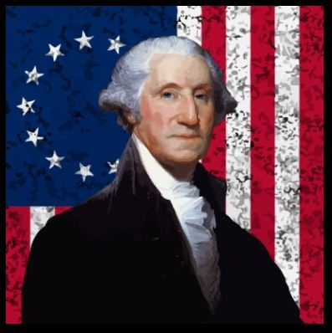
Policies of the Washington Administration

Slide 17
Policies of the Washington Administration
presidential candidate | political party | electoral votes
George Washington | no formally organized parties | 69
John Adams |  | 34
John Jay |  | 9
R.H. Harrison |  | 6
John Rutledge |  | 6
John Hancock |  | 4
George Clinton |  | 3
Samuel Huntington |  | 2
John Milton |  | 2
James Armstrong |  | 1
Benjamin Lincoln |  | 1
Edward Telfair |  | 1

Slide 18
Policies of the Washington Administration
The US Debt from the Revolutionary War had to be paid
$40 million owed to US Citizens
$11 million owed to foreign governments

Slide 19
Policies of the Washington Administration
Alexander Hamilton wanted to pay off the foreign debt first (so that we could borrow more if we needed to do so)

Slide 20
Policies of the Washington Administration
Thomas Jefferson wanted to pay of the domestic debt first (because the people deserve it)

Slide 21
Policies of the Washington Administration
Hamilton wanted to pay off the States’ debts as well
Most northern states had huge debts remaining from the war
Most southern states had already paid off their war debts
This is why Washington DC is located where it is – It is a compromise

Slide 22
Policies of the Washington Administration
John Adams Video
Disc 2 Part V
8:46-13:14 National Debt
30:14-35:05 Neutrality / Conflict within the Cabinet

Slide 24
The Whiskey Rebellion • Took place in Pennsylvania • 1791 tax on Whiskey (Why whiskey?) to raise money to pay off national debt • Farmers protested and refused to pay • Sound like Shay’s Rebellion? • 1794 Open rebellion – tarred and feathered tax collectors • The Courts determined that the US Government had the power to tax • 13,000 federal troops sent in to resolve the rebellion • How was this different than Shay’s rebellion?

Slide 25
Washington’s Farewell • Decided not to run for a third term – a precedent that stood until Roosevelt • Tired of public life • Did not want to die in office setting another precident • Fearful of Royalty (he was treated like a king) • Concerned about growing political conflicts • Concerned about political alliances drawing the USA into a foreign war • Farewell Address was actually a letter printed in the newspapers and not actually a speech.

Slide 26
Journal Entry - Washington Administration How did the Washington Administration affect your character? You must address all of the following for full credit 25 points. • Money / income / the economy • Taxes • Foreign entanglements • Growing political divide within the country • Interpretation of the Constitution • The Whiskey Rebellion • The French Revolution

Slide 27
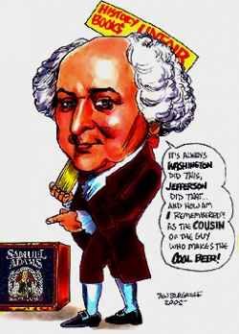
The John Adams Administration

Slide 28
Federalist Party
John Adams –the only Federalist President, wanted a strong federal government that supported industry and trade

Slide 29
Democratic-Republican Party
Thomas Jefferson and James Madison wanted a limit to the federal government’s power

Slide 30
Marbury v Madison
Supreme Court case which established the Supreme Court’s power to check the other branches of government. The case involved “midnight judges” appointed during Adams’ last days as President

Slide 31
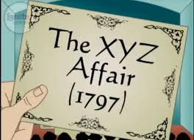
XYZ Affair
Washington remained neutral on foreign affairs
France wanted American privateers to attack British ships on behalf of France – Washington refused
Adams wanted warm relations with France
French diplomats wanted a bribe of $250,000 and a $12million loan in exchange for warm relations
The demands were refused
Federalists demanded war with France
Adams feared war, but Congress authorized money for 30 warships and a peacetime army
No formal declaration of war, but
American and French navies did fight
in the Caribbean.

Slide 32
Alien and Sedition Acts
Federalists passed 4 acts of Congress because they were angry over the opposition to war with France
The Sedition Act forbade anyone from criticizing the government – Unconstitutional?
Jefferson and Madison opposed the Acts
Acts remained in place until they expired several years later.

Slide 34
You Tube Election of 1800
http://www.youtube.com/watch?v=Y_zTN4BXvYI

Slide 35
The Election of 1800
Jefferson v Adams (incumbent)
Democrat-Republican vs Federalist
73 votes for Jefferson v 65 votes for Adams
Jefferson claimed that Adams wanted to crown himself king and wanted his own private Army
This election created a rift between the two that took decades to resolve
Jefferson Won the Election
1st successful peaceful transition of power from one political party to another
Tied electoral votes – election sent to House of Representatives to resolve
Tied votes in the house of Representatives – Jefferson won on the 36th vote taken
This election is the reason we have the 12th Amendment to the US Constitution

Slide 36
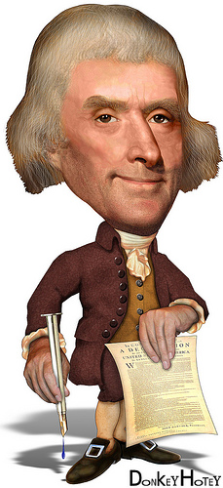
The Administration of Thomas Jefferson
Jefferson felt that the purpose of the US Government was to protect the nation from foreign threats, deliver mail and collect customs duties (taxes from imports) and that was all!
Had an incredibly small Administration of only several hundred people in Washington D.C.

Slide 37
The Louisiana Purchase
France
Napoleon conquered most of Europe
Wanted to re-establish a French colony on North America after gaining Louisiana from the Spanish
French at war with Britain
French needed money for war
Haitian slaves seize control of island and overthrow the French
Without control of Haiti, Napoleon lost interest in Louisiana
Saw an opportunity to sell to the Americans who seemed hungry for land.

Slide 38
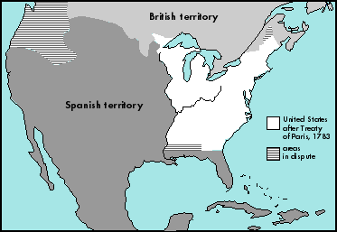

Slide 39
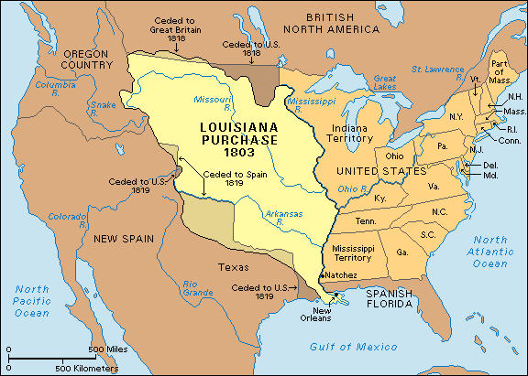

Slide 40
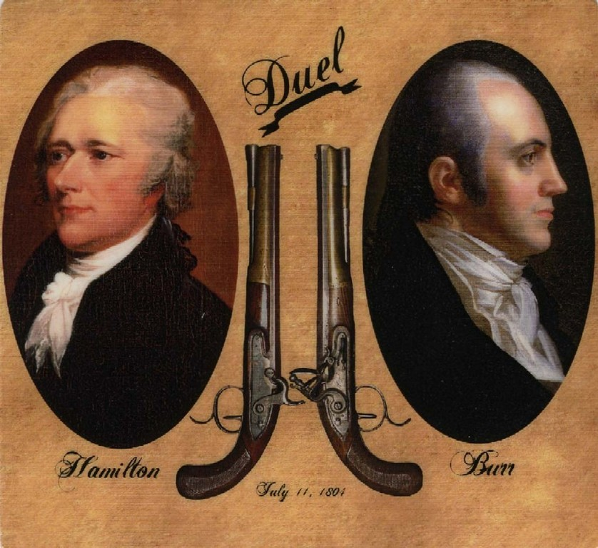

Slide 41
Burr Hamilton ESPN Duel
http://www.youtube.com/watch?v=BfeuU0NB5lg
http://vimeo.com/14785659

Slide 42
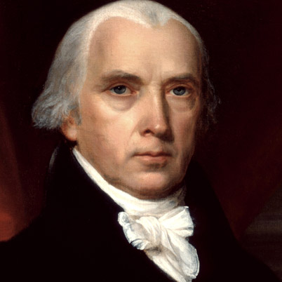
The James Madison Years

Slide 43
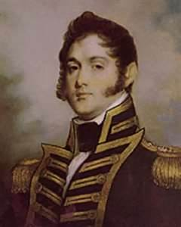
Oliver Hazard Perry
An American Commodore sent to break British control of Lake Erie “We have met the enemy and he is ours”

Slide 44
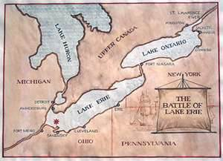
Battle of Lake Erie
American Naval victory which allowed Harrison to invade Canada

Slide 45
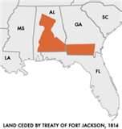
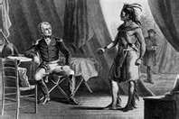
Treaty of Fort Jackson
Ended the war with the Creek Indians

Slide 46
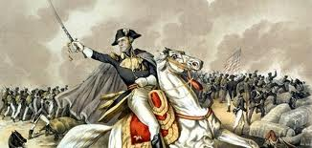
Battle of New Orleans
Last major battle of the War of 1812 which made Andrew Jackson a national hero. Fought in 1815 after the war had ended

Slide 47
Treaty of Ghent
Treaty signed in Belgium in 1814 which officially ended the War of 1812

Slide 48
Monroe Doctrine
Statement warning Europe to stay out of the Western Hemisphere

Slide 49
The War of 1812
US and Britain at war
Britain had hundreds of Battleships
America had less than 20 including the U.S.S. Constitution
Britain treated America like it was still a colony
Dictated which ports it could enter
Impressment of sailors into the British Navy
British ships blockaded American ports
Invasion of Canada:
Fort Detroit captured by Tecumseh and British Allies
State militias refused to fight on foreign soil
Battle of Lake Erie broke the British stranglehold on Lake Erie
General William Henry Harrison led the fight (later US President)

Slide 50
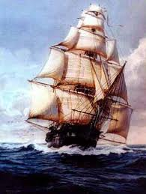
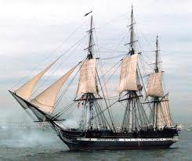
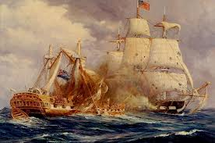
USS Constitution (a.k.a. Old Ironsides)

Slide 51
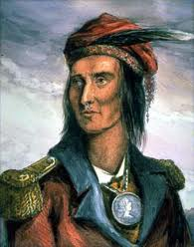
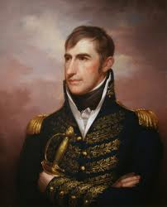
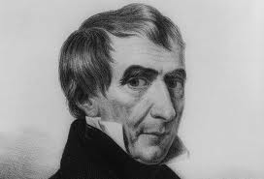
Tecumseh William Henry Harrison

Slide 52
Andrew Jackson
Commander of the Tennessee Militia
Fought Creek Indians who were angry with invading American settlers taking their lands
Battle of Horseshoe Bend, Alabama – 1814 American victory
Battle of New Orleans – 1815 American victory
Last battle of the War of 1812
Fought after the war ended
2000 British casualties
70 American casualties
Fought over control of the Mississippi River - WHY??
Battles with the Native Americans would galvanize his feelings towards them that would become very apparent during his presidency

Slide 53
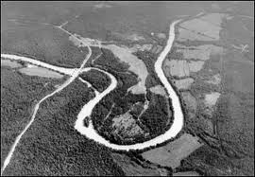
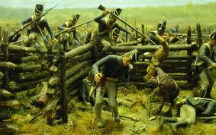
Battle of Horseshoe Bend

Slide 54
Washington D.C. during the War of 1812
British broke through the American defenses
President Madison fled the Capitol
First Lady Dolly Madison saved the portrait of George Washington
White house and the US Capitol building were burned

Slide 55
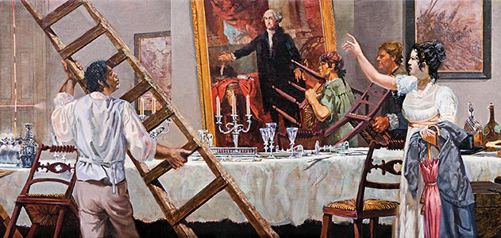
Dolly Madison Saves George Washington

Slide 56
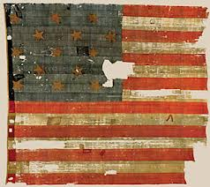
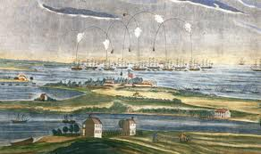
Star Spangled Banner
Fort McHenry guarded Baltimore
American forces held
Francis Scott Key wrote a poem about the battle while watching the battle

Slide 57
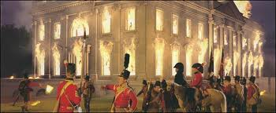
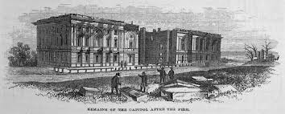
White
House
U.S.
Capitol
Building

Slide 58
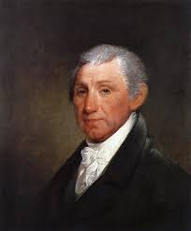
President
James Monroe
Elected 1816
Adams – Onis Treaty: Settled the Florida border issue giving Florida and New Orleans to America in exchange for America abandoning claims to Texas because Andrew Jackson had invaded Florida to attack the Seminole Indians
Rush-Bagot Agreement: Limited the British and American Naval presence on the Great Lakes – the reason we now enjoy such good relations with Canada

Slide 59
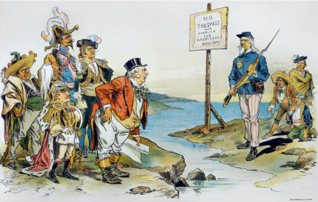
Monroe Doctrine

Slide 60
Monroe Doctrine
1) The U.S. would not interfere with the affairs of Europe (did we keep that pledge?)

Slide 61
Monroe Doctrine
The U.S. would not interfere with the affairs of Europe (did we keep that pledge?)
The U.S. would recognize and not interfere with existing European colonies in the Americas (Did we keep that pledge?)

Slide 62
Monroe Doctrine
The U.S. would not interfere with the affairs of Europe (did we keep that pledge?)
The U.S. would recognize and not interfere with existing European colonies in the Americas
(Did we keep that pledge?)
3) The Western Hemisphere was now off limits to any future colonization by any foreign power – Why?

Slide 63
Monroe Doctrine
The U.S. would not interfere with the affairs of Europe (did we keep that pledge?)
The U.S. would recognize and not interfere with existing European colonies in the Americas
(Did we keep that pledge?)
The Western Hemisphere was now off limits to any future colonization by any foreign power – Why?
The U.S. would consider any attempt by a foreign power to colonize or interfere with Western Hemisphere as a hostile act.

Slide 64
Newspaper Article
Write a newspaper article about the Monroe Doctrine:
From the viewpoint of an American reporter
From the viewpoint of a European reporter
Include an original political Cartoon for extra credit
One full page each

