Slide 1

UNIT EIGHT
Social Reform

Slide 2

Vocabulary
Nativists
US citizens who oppose immigration because they are suspicious of immigrants and fear losing their jobs

Slide 3
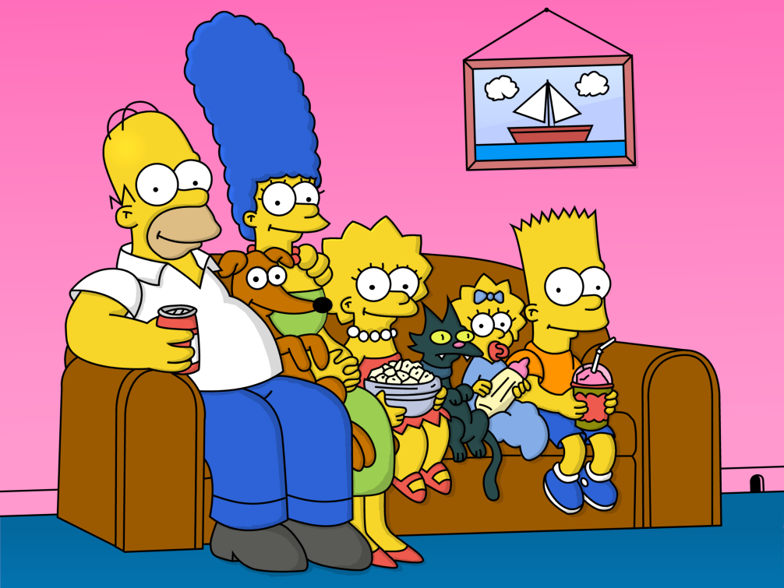
Vocabulary
Middle Class
The social and economic level between the wealthy and the poor

Slide 4
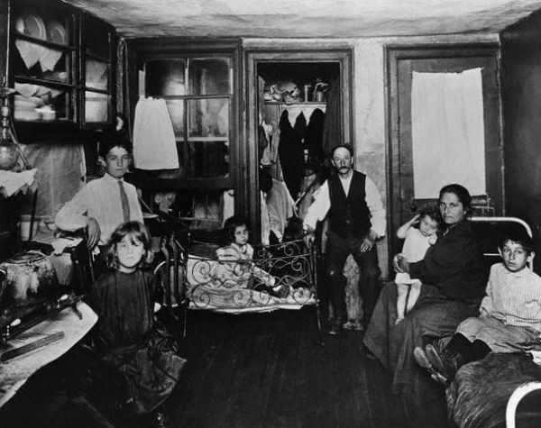
Vocabulary
Tenements
Poorly built, overcrowded housing where many immigrants lived

Slide 5
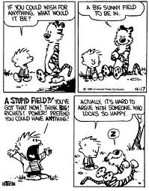
Vocabulary
Transcendentalism
The idea that people could rise above the material things in life

Slide 6
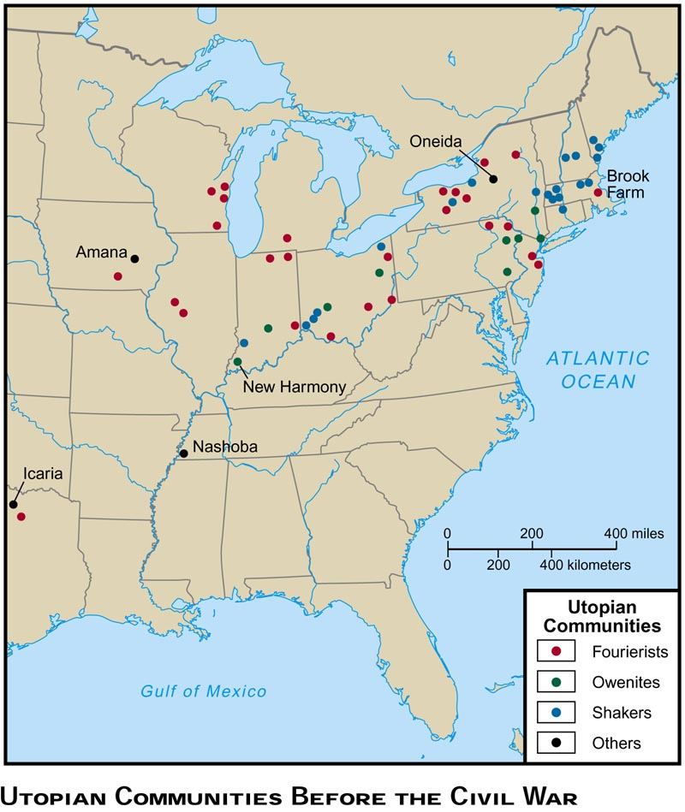
Vocabulary
Utopian Communities
Places where people worked to establish a perfect community

Slide 7
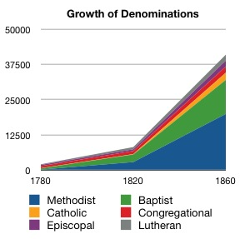
Vocabulary
Second Great Awakening
A period of religious evangelism that became widespread by the 1830s

Slide 8
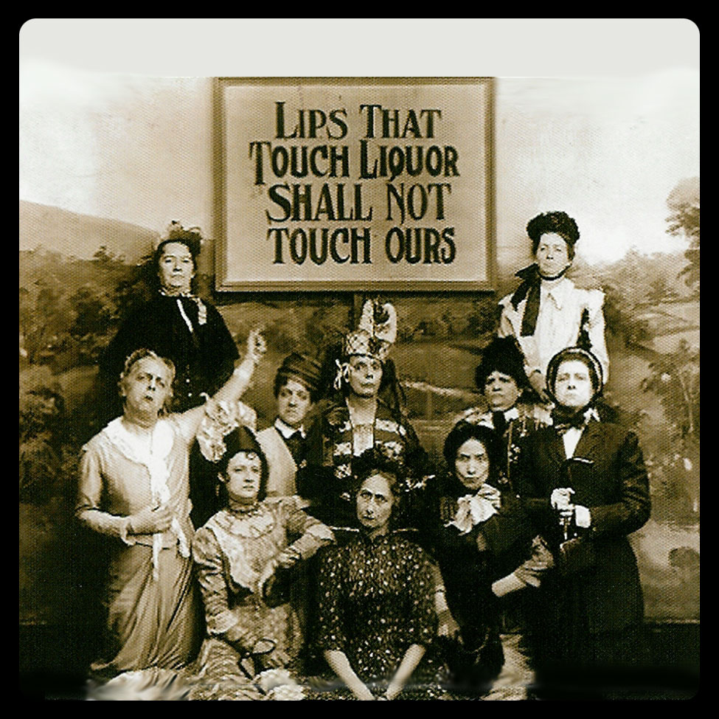
Vocabulary
Temperance Movement
A social reform effort to encourage people to consume less alcohol

Slide 9
Vocabulary
Temperance Movement
1905 Opium outlawed
1914 Cocaine outlawed
1920 Alcohol outlawed
(18th amendment, which was repealed by the 21st Amendment in 1933)
1931 Marijuana outlawed in 26 states

Slide 10
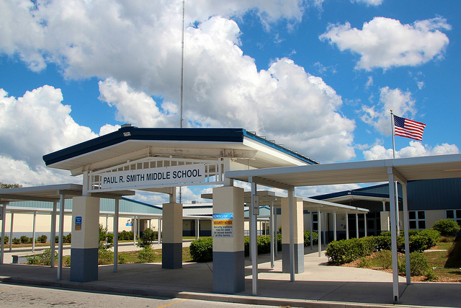
Vocabulary
Common School Movement
A social reform effort to have all children educated regardless of social class

Slide 11
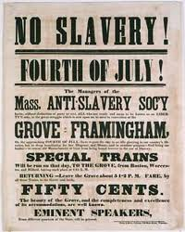
Vocabulary
Abolition
An end to slavery

Slide 12
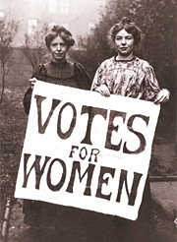
Vocabulary
Seneca Falls Convention
The first national women's rights convention during which the Declaration of Sentiments was written

Slide 13
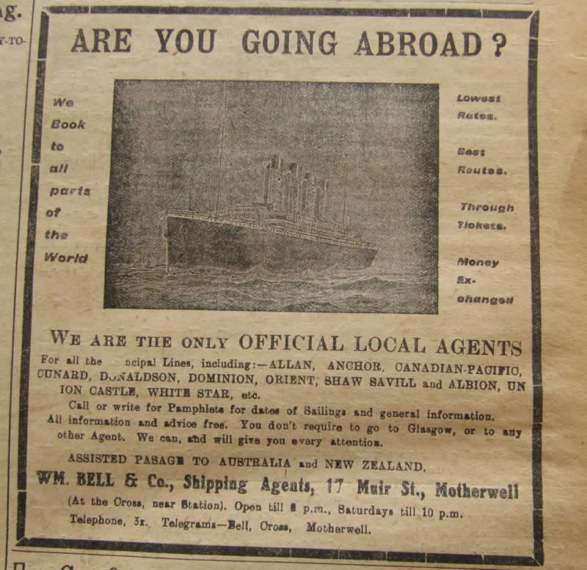
Urbanization
Advertisements in Northern Cities to attract workers

Slide 14
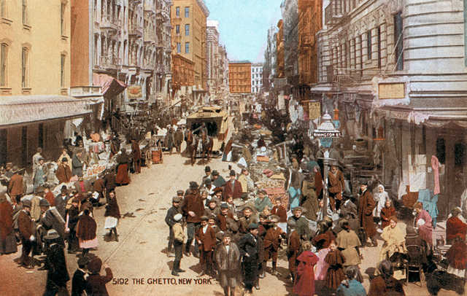
Urbanization
Advertisements in Northern Cities to attract workers
Growth of the Urban Ghetto

Slide 15
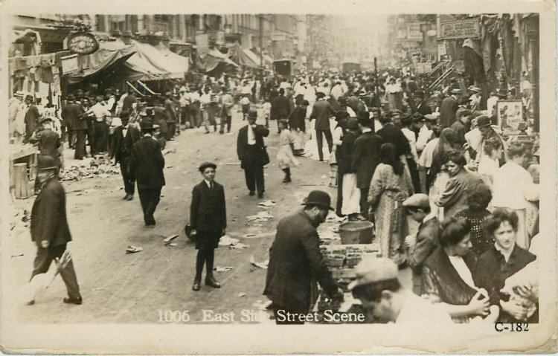
Urbanization
Advertisements in Northern Cities to attract workers
Growth of the Urban Ghetto
Crowded conditions

Slide 16
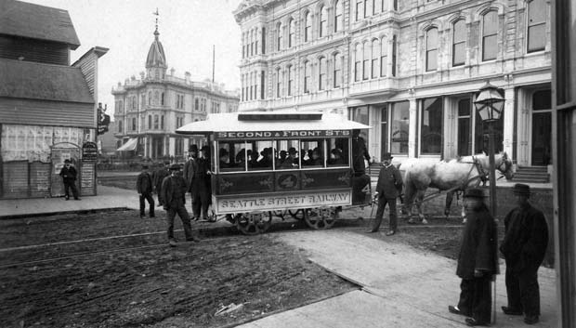
Improved Transportation

Slide 17
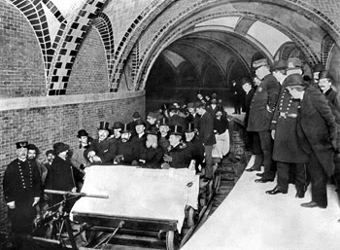

Slide 18
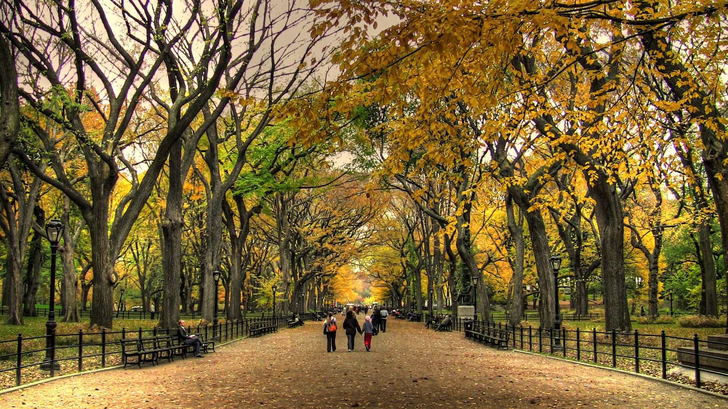
Central Park New York City

Slide 19
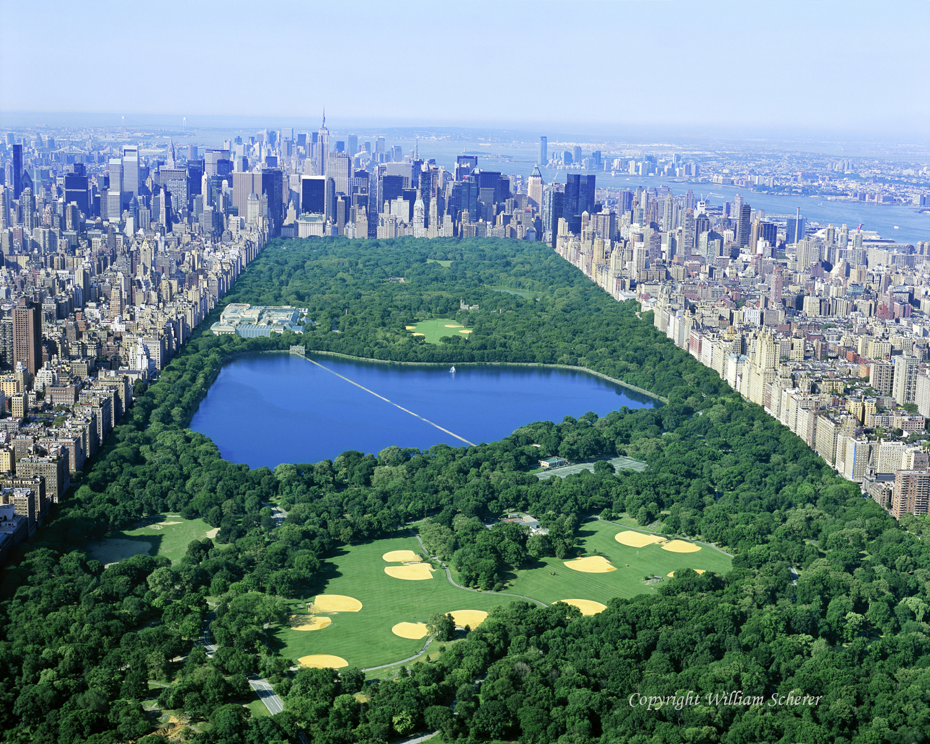
Why the Big Lake in the Middle of the Park?

Slide 20
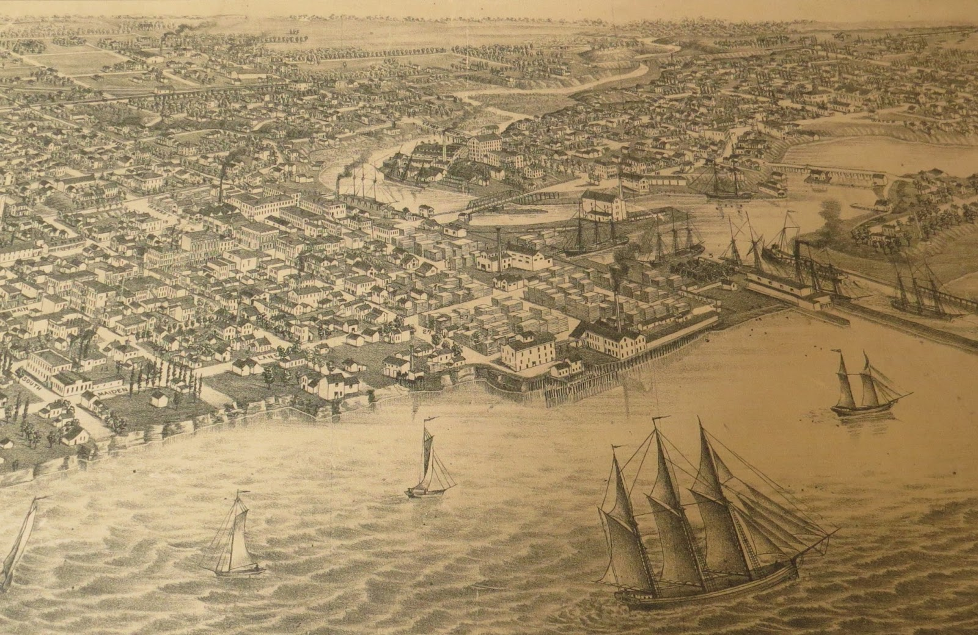
Kenosha – A Northern Port City

Slide 21
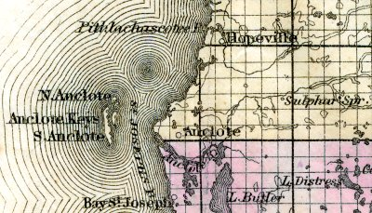
Tarpon Springs – A Southern Port City

Slide 22
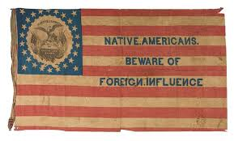
The Know Nothing Party
Official Called the American Party

Slide 23

The Know Nothing Party
Official Called the American Party
Made up of secret societies in American cities that opposed immigrants (mainly Irish and Catholics)

Slide 24
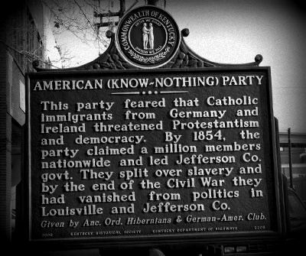
The Know Nothing Party
Official Called the American Party
Made up of secret societies in American cities
Members, when asked about the party would respond with
“I Know Nothing”

Slide 25
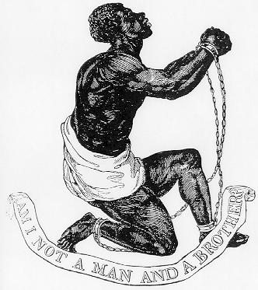
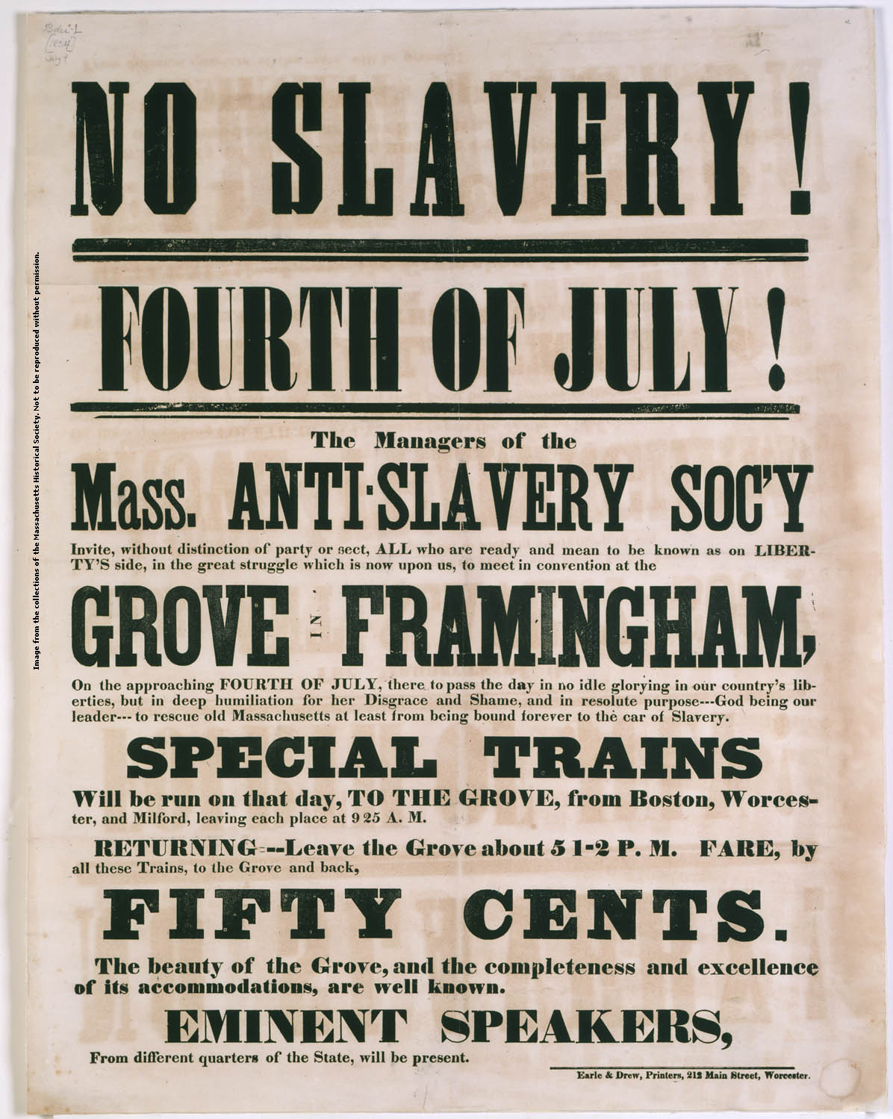
Abolition

Slide 26
Abolition Movement
Started by the Quakers in the 1700s

Slide 27
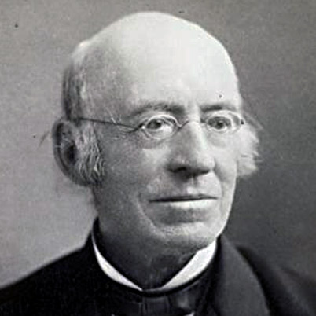
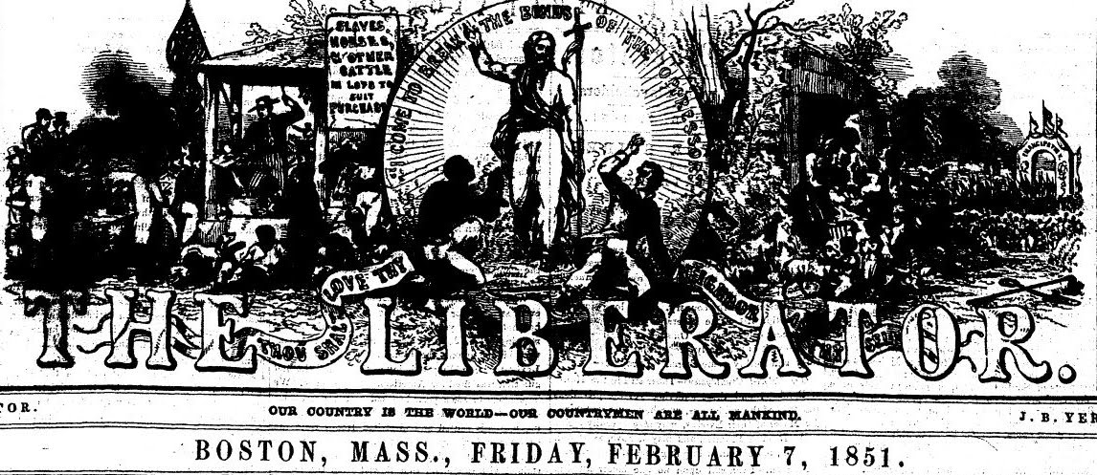
Abolition Movement
Started by the Quakers in the 1700s
William Lloyd Garrison

Slide 28
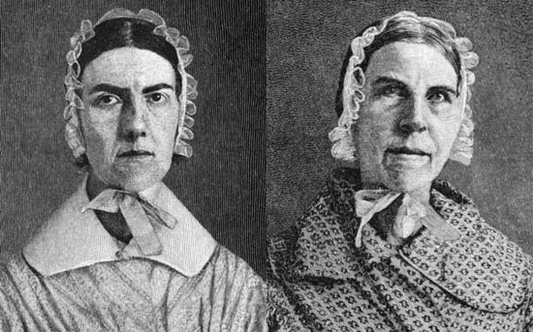
Abolition Movement
Started by the Quakers in the 1700s
William Lloyd Garrison
Anti-Slavery Societies
Angelina and Sarah Grimke

Slide 29
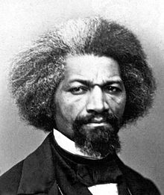
Abolition Movement
Started by the Quakers in the 1700s
William Lloyd Garrison
Anti-Slavery Societies
Angelina and Sarah Grimke
Frederick Douglas

Slide 30
Abolition Movement
Started by the Quakers in the 1700s
William Lloyd Garrison
Anti-Slavery Societies
Angelina and Sarah Grimke
Frederick Douglas
Underground Railroad – not an actual railroad
Harriet Tubman helped 300 slaves escape slavery

Slide 31
The Underground Railroad
Neither underground nor a railroad, but rather a system of loosely connected safe havens where escaped slaves could find food, clothing and shelter during their journey to freedom.

Slide 32
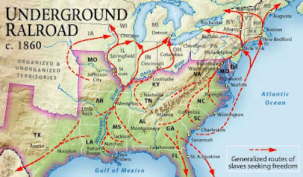
The Underground Railroad

Slide 33
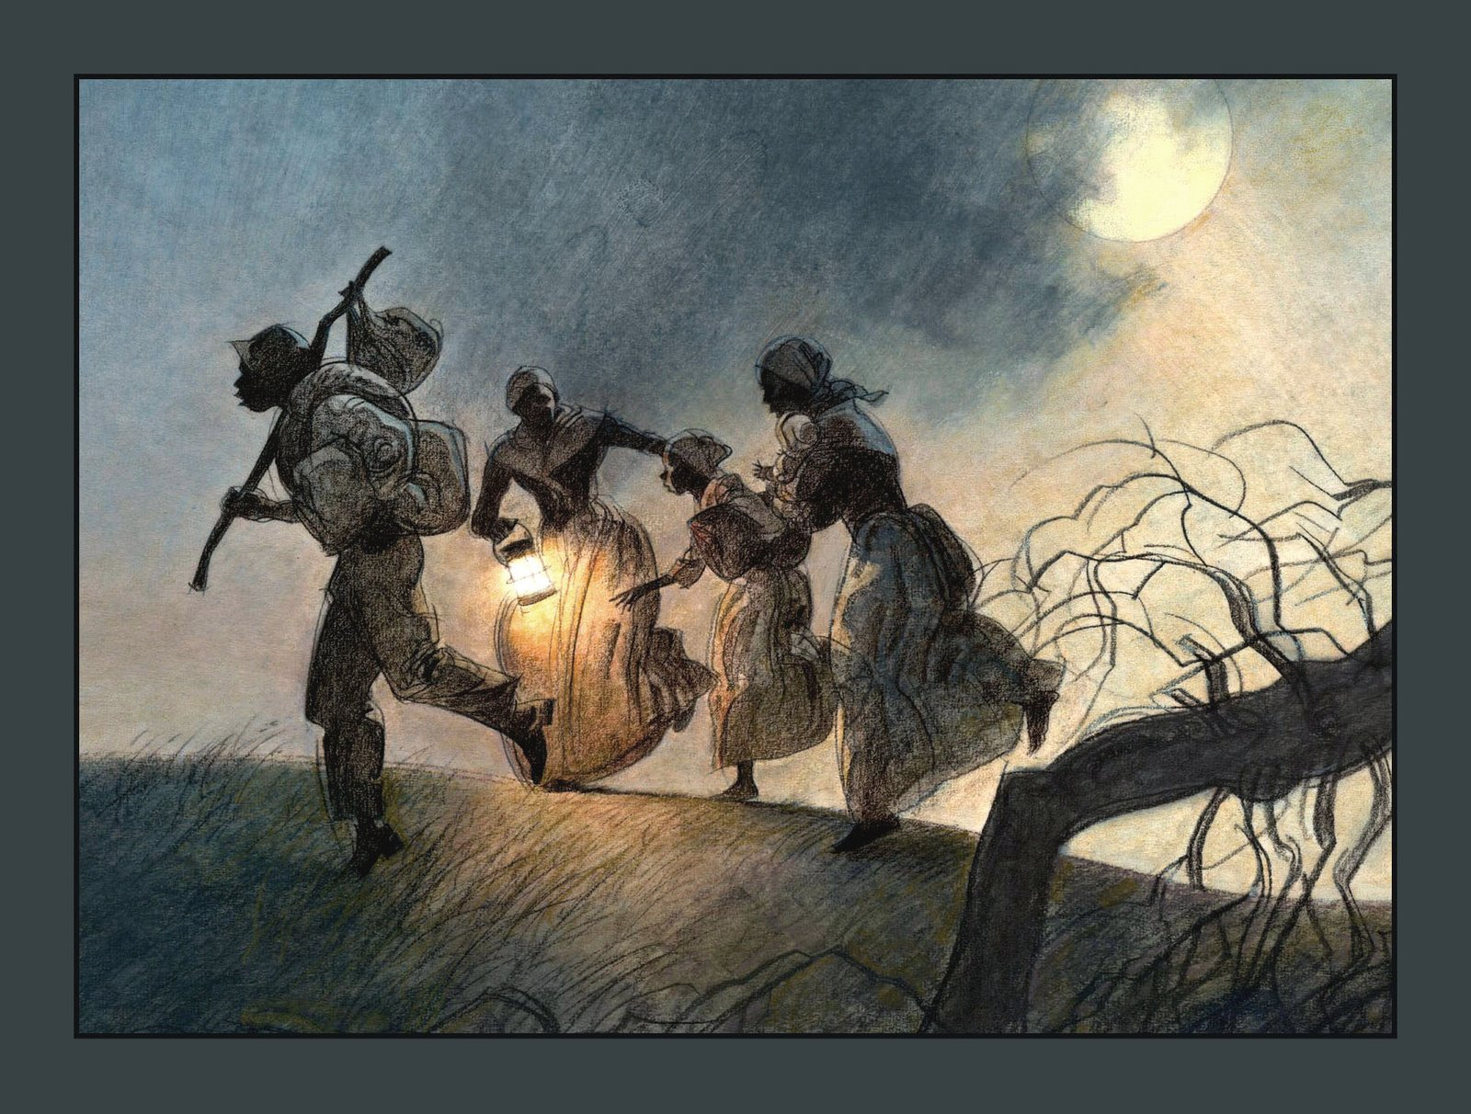
The Underground Railroad

Slide 34
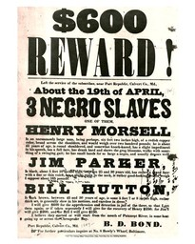
The Underground Railroad

Slide 35
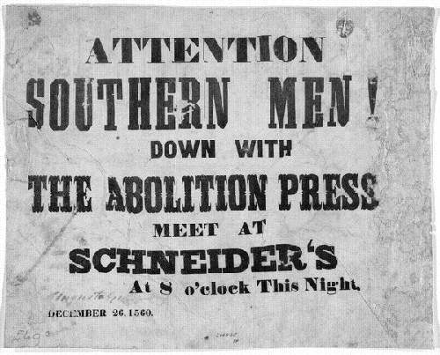
Anti-Abolition

Slide 36
Women’s Rights Movement
Abolition – A training ground for women’s rights

Slide 37
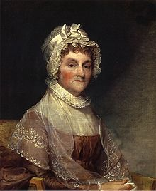
Women’s Rights Movement
Abolition – A training ground for women’s rights
Abigail Adams

Slide 38
Women’s Rights Movement
Abolition – A training ground for women’s rights
Abigail Adams
Seneca Falls Convention
Declaration of Sentiments

Slide 39
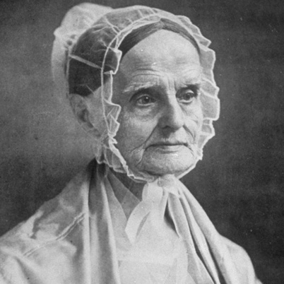
Women’s Rights Movement
Abolition – A training ground for women’s rights
Abigail Adams
Seneca Falls Convention
Declaration of Sentiments
Lucretia Mott

Slide 40
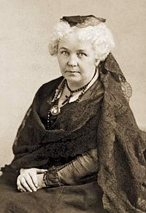
Women’s Rights Movement
Abolition – A training ground for women’s rights
Abigail Adams
Seneca Falls Convention
Declaration of Sentiments
Lucretia Mott
Elizabeth Cady Stanton

Slide 41
Women’s Rights Movement
Abolition – A training ground for women’s rights
Abigail Adams
Seneca Falls Convention
Declaration of Sentiments
Lucretia Mott
Elizabeth Cady Stanton
19th Amendment to the US Constitution

Slide 42
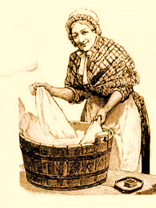
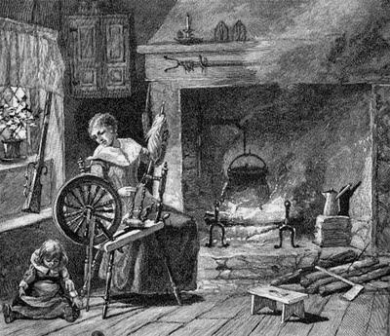
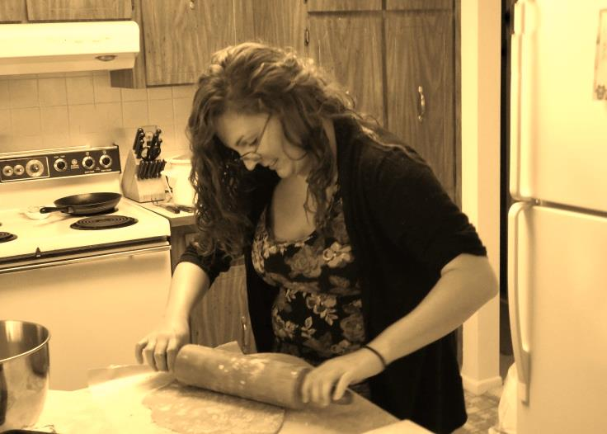
Why do Women Need Rights?

Slide 43
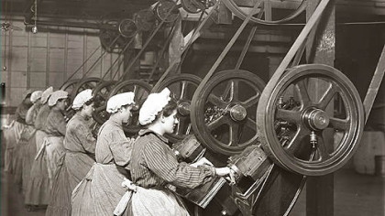
Why do Women Need Rights?

Slide 44
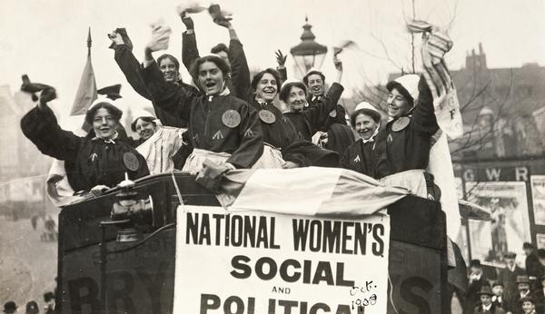
Why do Women Need Rights?

Slide 45
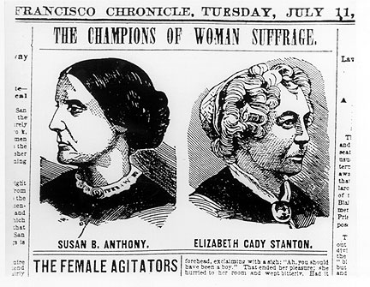
Why do Women Need Rights?

Slide 46
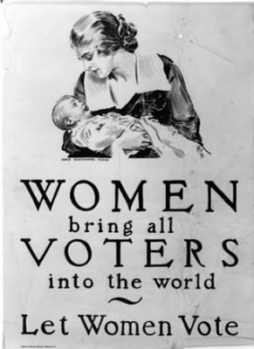
Why do Women Need Rights?

Slide 47
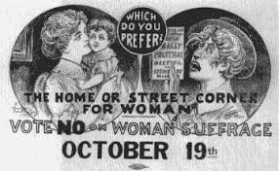
Not all Men Agreed

Slide 48
TITLE
Mr. : Mister – the head of the household; the master of his domain
Mr. Roger Heffron
Mstr. : Master – The young variant of Mister; used until the age of 18; Mister is actually an ancient slang for Master
Master Deontrae Stacey
Sir : (Slang for Sire) The formal address of a man regardless of age
Yes Sir, I will turn in my homework.

Slide 49
TITLE
Mrs. : Mistress – The married female head of the household; current pronunciation is slang for Mistress
Mrs. Roger Heffron (my wife)
Miss : Miss- The unmarried variant of Mistress; an unmarried young lady
Miss Onorati
Ms. : Miz – An unmarried or married woman; Term was created by the Women’s Equality movement of the 1970s
Ms. Straker
Madam : The formal address of a mature woman regardless of marital status
May I help you Madam?
Ma’am: The formal address of a young lady
Yes Ma’am, you may use the bathroom.

Slide 50


Slide 51
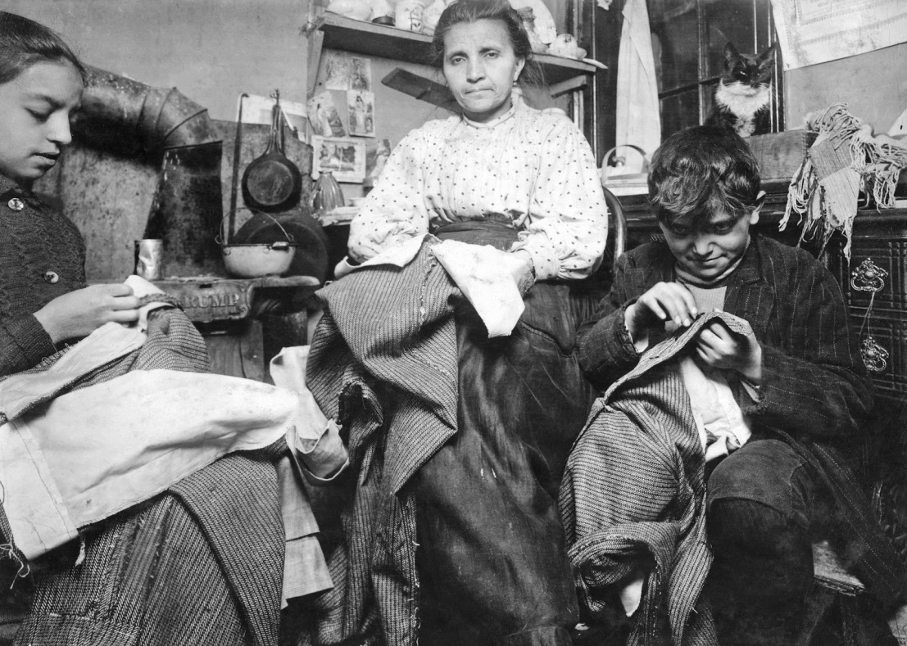
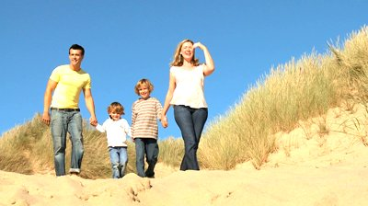
Leisure time 1850
Oh wait – there is no leisure time yet
Leisure time 2014
Oh yeah – just a tad bit more leisure time

Slide 52
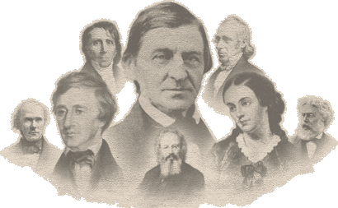
Transcendentalism

Slide 53
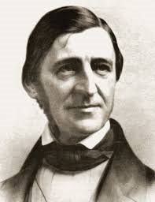
Ralph Waldo Emerson
American poet, essayist, and philosopher

Slide 54
Ralph Waldo Emerson
Emerson's philosophy is characterized by its reliance on intuition as the only way to comprehend reality

Slide 55
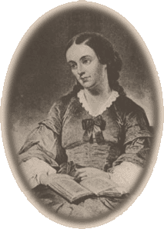
Margaret Fuller
The Dial: A Magazine for Literature, Philosophy, and Religion

Slide 56
Henry David Thoreau
Cranky Old Hermit
Do not hire a man who does your work for money, but him who does it for love of it.

Slide 57
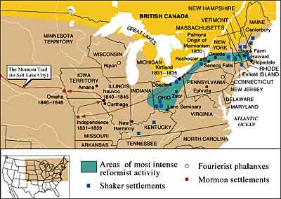

Slide 58
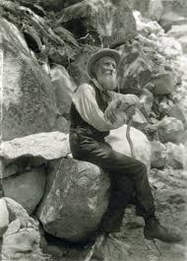
John Muir
Naturalist
Protect Nature rather than use it

Slide 59
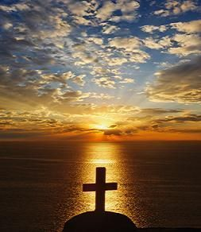
Second Great Awakening
Methodists
Baptists
Presbyterians
Millerites
Mormons
Unitarians
7th Day Adventists
Church of Christ

Slide 60
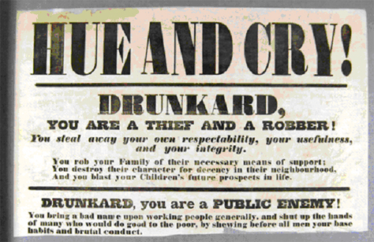
Temperance

Slide 61

Irish Catholic Immigrants

Slide 62

Irish Catholic Immigrants

Slide 63

German Catholic Immigrants

Slide 64

German Catholic Immigrants

Slide 65

Protestant Reaction

Slide 66

Temperance Movement

Slide 67

Temperance Movement

Slide 68

Temperance Movement

Slide 69

Prison Reform
Dorothea Dix

Slide 70
Prison Reform
Dorothea Dix
Mentally ill people should be in Mental Hospitals instead of Prisons

Slide 71

Education Reform

Slide 72

Education Reform
Land Ordinance of 1787
Each township must have a school

Slide 73

Education Reform
The One Room Schoolhouse

Slide 74

Education Reform
Pasco County’s First School Bus

Slide 75
Education Reform
Typical 6th Grade Education

Slide 76
Education Reform
Typical 6th Grade Education
Teacher requirements: Complete the 6th Grade

Slide 77
Education Reform
Typical 6th Grade Education
Teacher requirements: Complete the 6th Grade
Creation of School Boards

Slide 78
Education Reform
High Schools –early 1800s

Slide 79
Education Reform
High Schools –early 1800s
Junior High Schools – grades 7-9: 1920 = 833 nationwide

Slide 80
Education Reform
High Schools –early 1800s
JH Schools grades 7-9:
1920 = 833 nationwide
Middle Schools
  for me 1976

Slide 81
Education Reform
Establishment of Normal Schools (Teacher Education Schools)

Slide 82
Education Reform
Establishment of Normal Schools (Teacher Education Schools)
Growth of the Nation’s University system

Slide 83

The Grimke Sisters
Frederick Douglas
Harriet Tubman

Slide 84

Elizabeth Cady Stanton
Abigail Adams
Susan
B
Anthony
Lucretia Mott

Slide 85
^{Creating S.M.A.R.T. Goals}
^{Goals should be specific.}
Goals should be measurable. Have a
yardstick for measuring outcomes.
Goals should be attainable. Draft realistic goals that challenge you
Goals should be relevant. Make sure each goal is consistent with other goals you have established and fits with your immediate and long-range plans.
Goals should be time bound. Give yourself time to achieve your goals.

Slide 86
Specific - A specific goal has a much greater chance of being accomplished than a general goal. To set a specific goal you must answer the six "W" questions:
*Who: *What: *Where: *When: *Which: *Why:
^{Who is involved?}
^{What do I want to accomplish?}
^{Identify a location.}
^{Establish a time frame.}
Identify requirements and constraints.
Specific reasons, purpose or benefits of accomplishing the goal.
Measurable - Establish concrete criteria for measuring progress toward the attainment of each goal you set. To determine if your goal is measurable, ask questions such as......How much? How many? How will I know when it is accomplished?
Attainable - When you identify goals that are most important to you, you begin to figure out ways you can make them come true. You develop the attitudes, abilities, skills, and financial capacity to reach them.

Slide 87
Realistic - To be realistic, a goal must represent an objective toward which you are both willing and able to work. A goal can be both high and realistic; you are the only one who can decide just how high your goal should be. Your goal is probably realistic if you truly believe that it can be accomplished.
Time Bound - A goal must have a target date. If you desire to make a million dollars, but don't set the timeline for it, it won't be motivating. A deadline too far in the future is too easily put off. A goal that's set too close is not only unrealistic, it's discouraging.
Long Term Goals: long term goals are simply a description of what you want for yourself in the future -- say about 3 to 5 years out. The best way to define them is to give examples: graduate college, get a good job, find a life partner, get rich quick, etc... A goal is not a plan, it's more like a wish list with (hopefully) a basis in reality.
Then set short term goals to reach that plan.
What can I do 6 months from now? What can I do 6 weeks from now? What can I do today?

