Slide 1
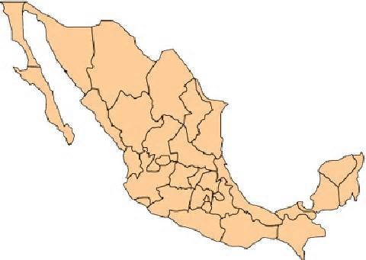
Spain
Which of the countries listed below chose to colonize in the area that is known today as Mexico and the southwestern United States? This country also felt that spreading the Catholic faith was an important part of their purpose for colonization.
Spain ?
France ?
Netherlands ?
England ?

Slide 2
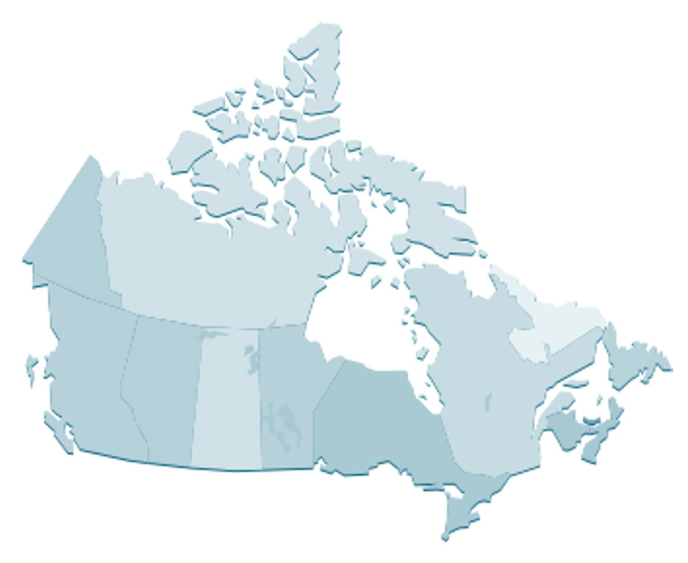
Which of the countries listed below chose to colonize in the area that is known today as Canada and the eastern coast of the United States? This country also felt that finding an outlet for their island’s manufactured goods was an important part of their purpose for colonization.
England
Spain ?
France ?
Netherlands ?
England ?

Slide 3
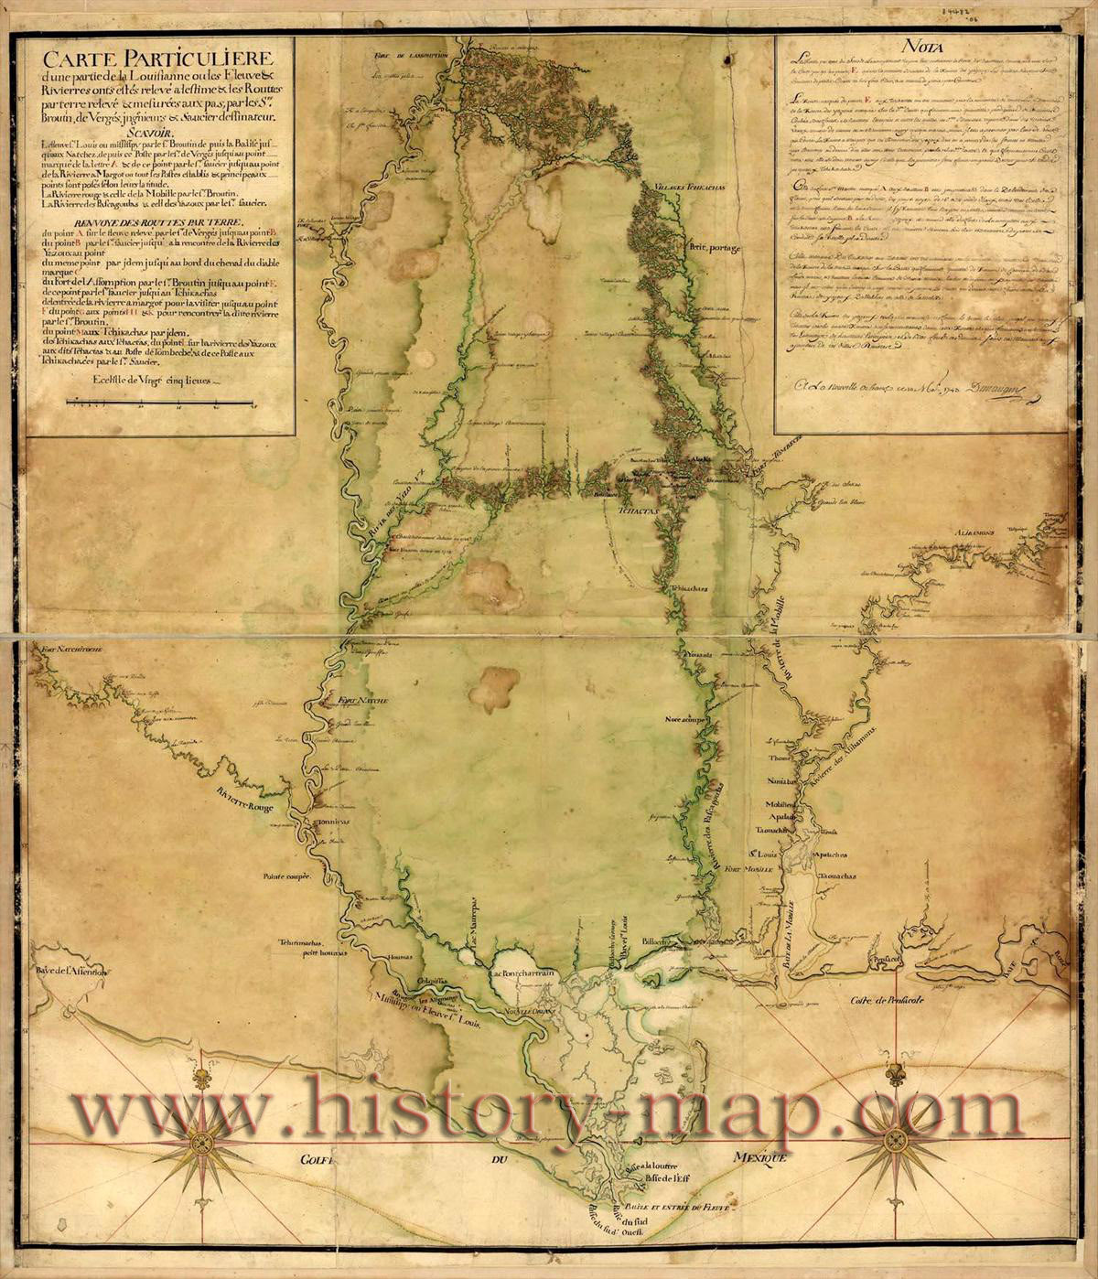
Which of the countries listed below chose to colonize in the area that is known today as Louisiana and the Mississippi valley? This country also felt finding the Northwest Passage was an important part of their purpose for exploration.
Spain ?
France ?
Netherlands ?
England ?
France

Slide 4
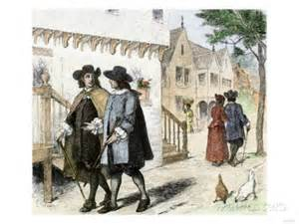
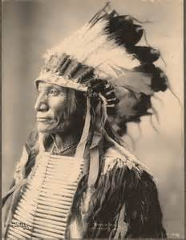
Which of the following statements would be an example of the type of relationship that existed between the Native Americans and the English settlers?
The Natives and settlers had a very close relationship. Natives openly converted to the Protestant faith and moved into the villages that the settlers set up.
The settlers and the Native Americans were constantly at odds. Natives were forced to work in gold and silver mines with very little regard for their desires.
The settlers and the Native Americans were constantly arguing over land. The Native Americans were pushed beyond the Appalachian Mountains and thought of as savages.
The settlers and Native Americans had a great deal of intermarriage and traded furs for manufactured items.
The settlers and the Native Americans were constantly arguing over land. The Native Americans were pushed beyond the Appalachian Mountains and thought of as savages.

Slide 5
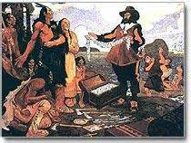
Which of the following statements would be an example of the type of relationship that existed
between the Native Americans and the Spanish settlers?
The settlers and the Native Americans were constantly at odds. Natives were forced to work in gold and silver mines with very little regard for their desires.
The settlers and Native Americans had a great deal of intermarriage and traded furs for manufactured items.
The Natives and settlers had a very close relationship. Natives openly converted to the Protestant faith and moved into the villages that the settlers set up.
The settlers and the Native Americans were constantly arguing over land. The Native Americans were pushed beyond the Appalachian Mountains and thought of as savages.
The settlers and the Native Americans were constantly at odds. Natives were forced to work in gold and silver mines with very little regard for their desires.

Slide 6
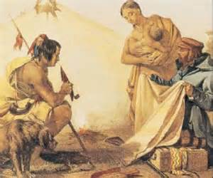
Which of the following statements would be an example of the type of relationship that existed between the Native Americans and the French settlers?
The settlers and Native Americans had a great deal of intermarriage and they also traded fur for manufactured items.
The settlers and Native Americans had a great deal of intermarriage and they also traded fur for manufactured items.
The settlers and the Native Americans were constantly at odds. Natives were forced to work in gold and silver mines with very little regard for their desires.
The settlers and the Native Americans were constantly arguing over land. The Native Americans were pushed beyond the Appalachian Mountains and thought of as savages.
The Natives and settlers had a very close relationship. Natives openly converted to the Protestant faith and moved into the villages that the settlers set up.

Slide 7
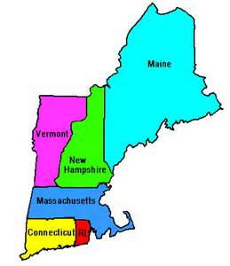
What did the New England Colonies have in common?
Harsh winters and rocky, hilly land
Long, hot summers and mild winters
Broad rivers, swamps, and wetlands
Broad coastal plains with fertile soil
Harsh winters and rocky, hilly land

Slide 8
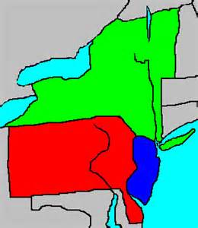
The people who settled in the Middle Colonies represented
Many Diverse countries & cultures
Many Diverse countries & cultures
Pilgrims & Puritans
Debtors from England
Africans escaping slavery

Slide 9
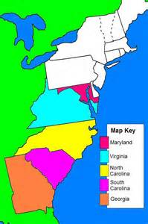
What feature made the Southern Colonies unique?
Large plantations
Shipbuilding centers
Large plantations
Town meetings
Quaker communities

Slide 10
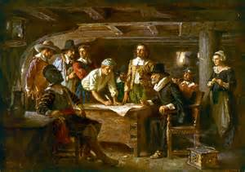
The Mayflower Compact, the Fundamental Orders, and town meetings all showed the determination of colonists to
Govern themselves and solve their own problems.
Build societies based on religious freedom.
Stop indentured servants from coming to America.
Govern themselves and solve their own problems.
Solve conflicts with Native Americans peacefully.

Slide 11
Which generalization best sums up the founding of the English colonies?
The English colonies were founded by people with different goals ranging from making money to following their faith.
The English colonies were founded by Puritans, Quakers, and Catholics who wanted a place to worship in peace.
The English colonies were founded to provide a new start to poor people throughout Europe.
The English colonies were founded by business people who planned to make money by selling land to settlers.
The English colonies were founded by people with different goals ranging from making money to following their faith.

Slide 12
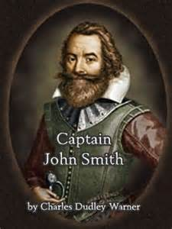
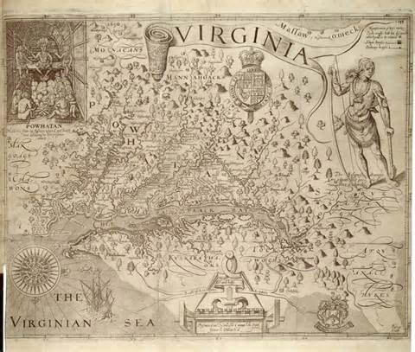
What impact did John Smith have on the colony of Virginia?
In order to help the Jamestown settlement survive, he set up strict rules that forced settlers to work or they wouldn’t be fed.
He encouraged people to come to Virginia to escape religious persecution.
He developed the law making body of Virginia called the House of Burgesses.
He was the first settler to bring African slaves to Virginia.
In order to help the Jamestown settlement survive, he set up strict rules that forced settlers to work or they wouldn’t be fed.

Slide 13
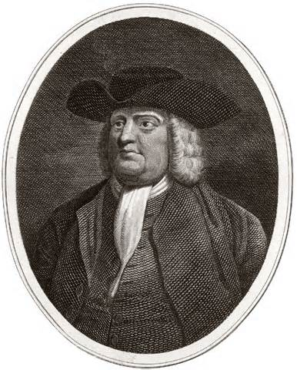
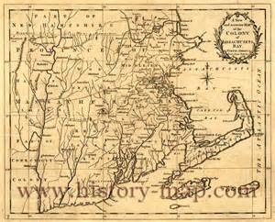
What impact did William Penn have on the development of Pennsylvania?
He helped start a militia to defend the colony.
He signed the Declaration of Independence for the colony of Pennsylvania
He wanted to set up a place for Quakers to practice their religion without fear.
He organized a plan for starting a colony in America for the poor and persecuted in Britain, where one group might find relief from poverty, the other from political persecution.
He wanted to set up a place for Quakers to practice their religion without fear.

Slide 14
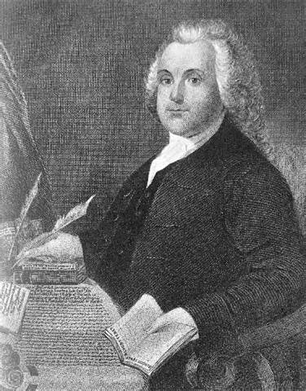
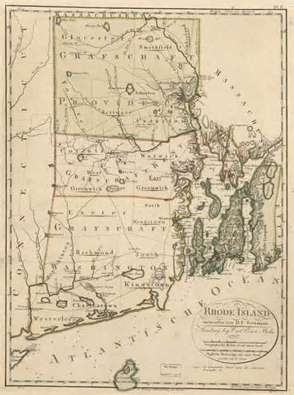
What impact did Roger Williams have on the development of Rhode Island?
He wanted to set up a safe place for Catholics to settle.
He wanted to set up an alternative to the colony of Massachusetts in New England where people could practice religion as they wished.
He challenged the theory of mercantilism.
He helped write the Fundamental Orders of Rhode Island.
He wanted to set up an alternative to the colony of Massachusetts in New England where people could practice religion as they wished.

Slide 15
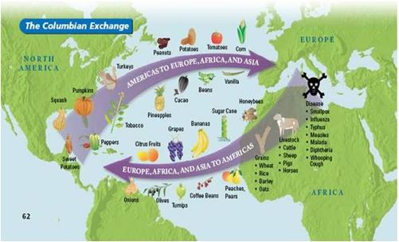
In its economic relationship with its North American colonies, Great Britain followed the principles of 18th-century mercantilism by
Outlawing the African slave trade.
Limiting the colonies’ trade with other nations.
Encouraging the development of manufacturing in the colonies.
Establishing laws against business monopolies.
Limiting the colonies’ trade with other nations.

Slide 16
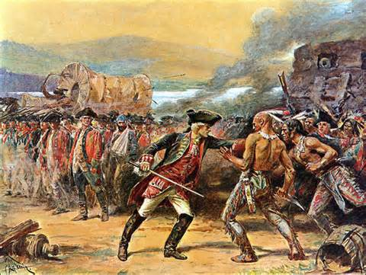
Which of the following is an example of how the French and Indian War impacted colonial life?
It caused the English colonists to come under tighter restrictions by the British.
It eventually caused settlement west of the Appalachian Mountains to end.
It allowed Native Americans to receive much of their original land back.
2 Answers
2 Answers
It caused the English colonists to come under tighter restrictions by the British.
It eventually caused settlement west of the Appalachian Mountains to end.

Slide 17
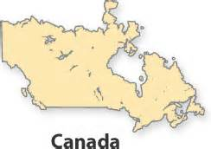
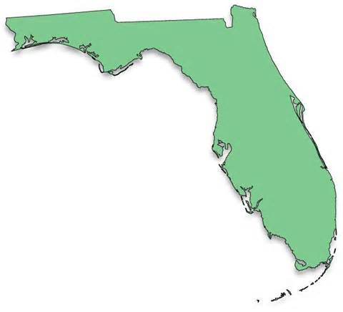
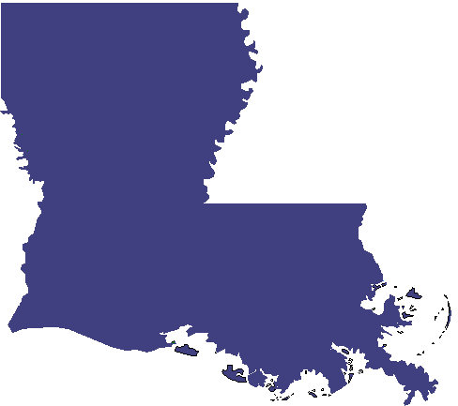
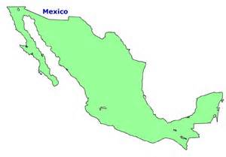
What large land area was added to the British empire after the French and Indian War?
Canada ? Louisiana ? Florida ? Mexico ?

Slide 18
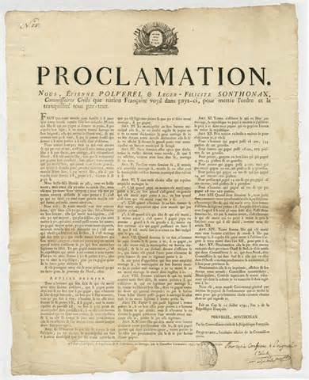
Although the Proclamation of 1763 was designed to promote peace, instead it
Triggered wars between Indian groups.
Angered many colonists who wanted to stay in the Ohio Valley.
Sparked a boycott of British goods.
Led to riots in colonial cities.
Angered many colonists who wanted to stay in the Ohio Valley.

Slide 19
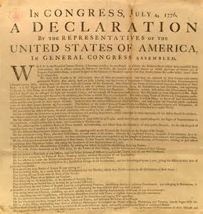
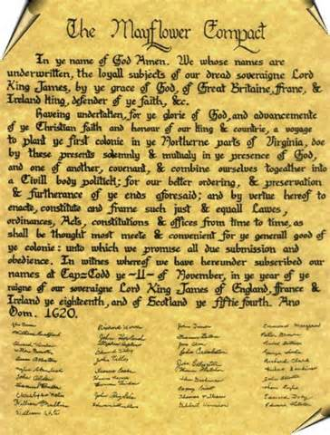
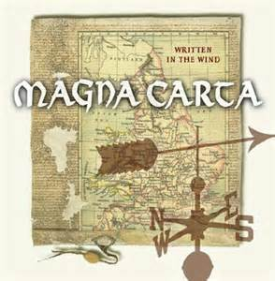
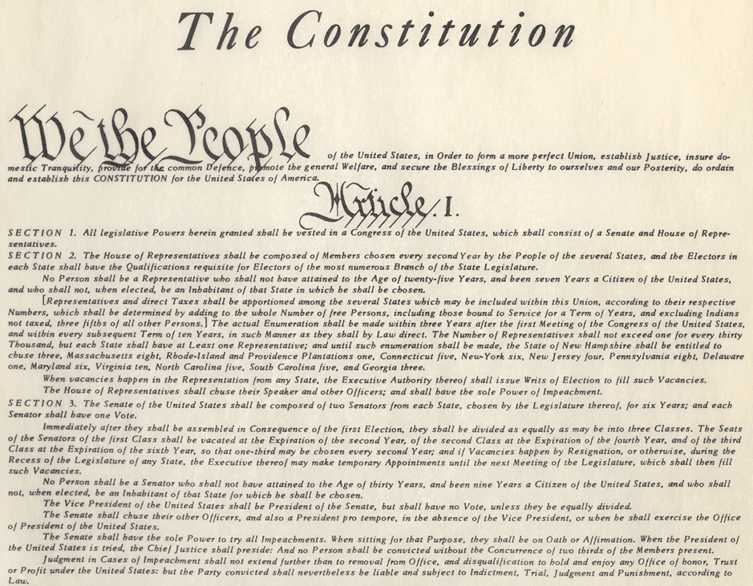
Which primary document contains these words penned by Thomas Jefferson, “We hold these truths to be self evident, that all men are created equal. . .”?
Mayflower Compact
Magna Carta
Declaration of Independence
U. S. Constitution

Slide 20
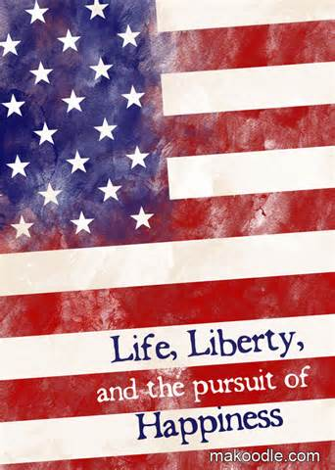
What are three natural rights listed in the Declaration of Independence?
Life, liberty, and the pursuit of happiness
Taxes, elections, and freedom of speech
Trial by jury, freedom of the press, freedom of speech
Equality, liberty, and free speech
Life, liberty, and the pursuit of happiness

Slide 21
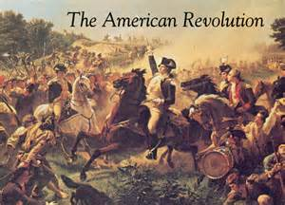
What battle was considered the “turning point” of the American Revolution?
Saratoga Ticonderoga
Trenton Bunker Hill
Saratoga

Slide 22
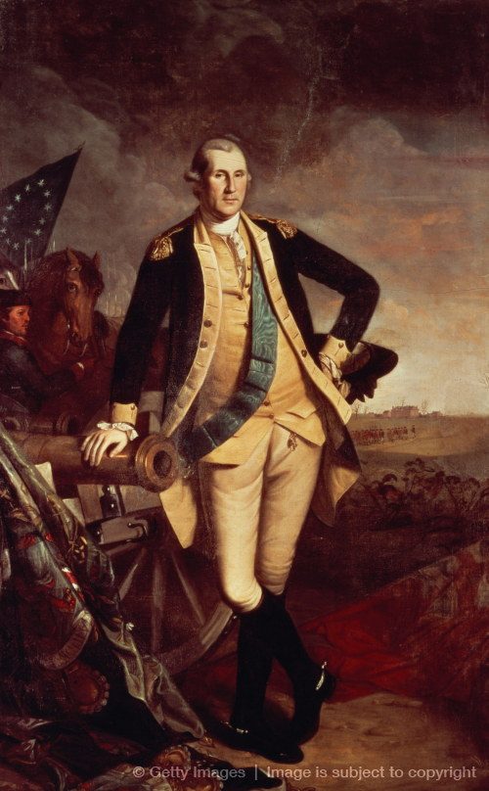
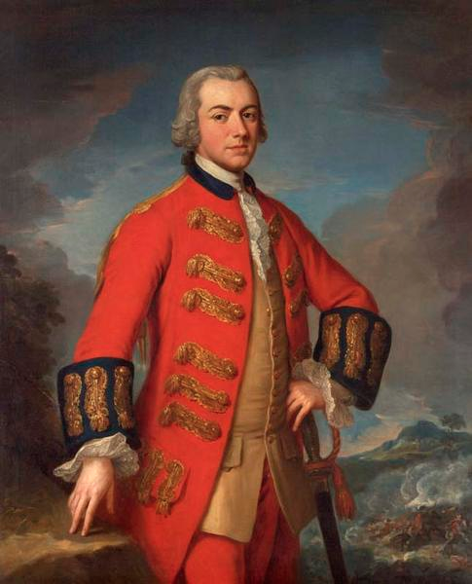
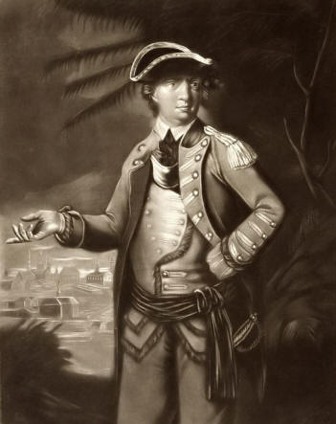
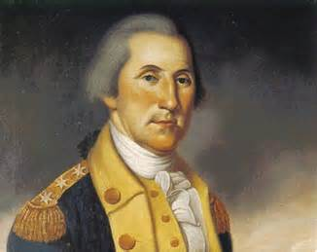
Who was chosen as the leader of the Continental Army?
Ethan Allen Benedict Arnold
George Washington Charles Cornwallis
George
Ethan Allen
B. Arnold
Cornwallis

Slide 23
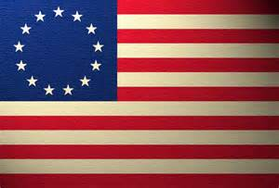
Look at the terms of the Treaty Of Paris and determine which side would have negotiated that term of peace.
Americans ? British ? Both ?
Recognized the 13 colonies as free and independent states
Great Britain and the United States were each to be given unblocked access to the Mississippi River.
Territories captured by Americans, after the treaty was written, will be returned without payment from the British government.

Slide 24
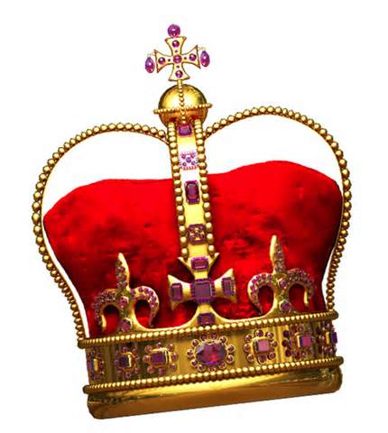
When the thirteen colonies rebelled in 1775, East and West Florida remained loyal to the King. What Florida settlement became a center of Loyalist activity?
Tallahassee ? Pensacola ? St. Augustine ? Live Oak ?
St. Augustine

Slide 25
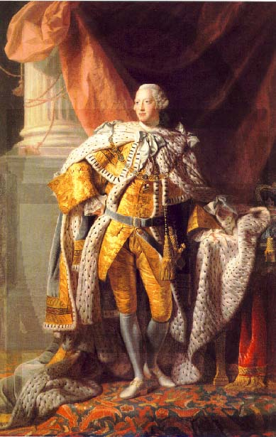
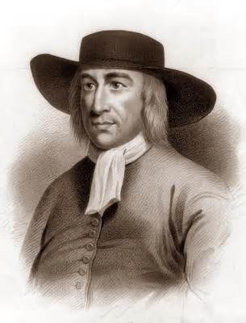
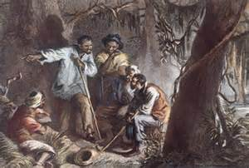
How did the American government change after the war?
The government obtained its authority from the citizens and was responsible to them.
The King of England appointed an aristocratic family to rule the colonies.
African Americans took leadership roles in the new government.
The Quaker ideal of pacifism was a central belief of the new government.
The government obtained its authority from the citizens and was responsible to them.

Slide 26
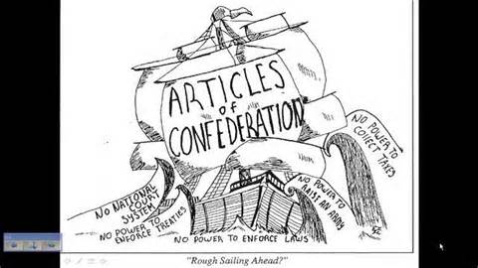
The Articles of Confederation did all of the following except
Serve as the first plan of government for the United States.
Form a loose union of the states.
Divide power among three branches of government.
Give Congress power to make war and peace
Divide power among three branches of government.

Slide 27
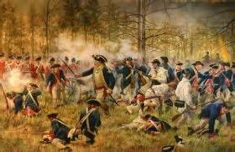
Shays’ Rebellion is best remembered today because it
Threatened law and order in Massachusetts.
Dramatized the money problems faced by poor farmers.
Shocked Congress into calling for a Constitutional Convention.
Showed how well the Articles of Confederation worked.
Shocked Congress into calling for a Constitutional Convention.

Slide 28
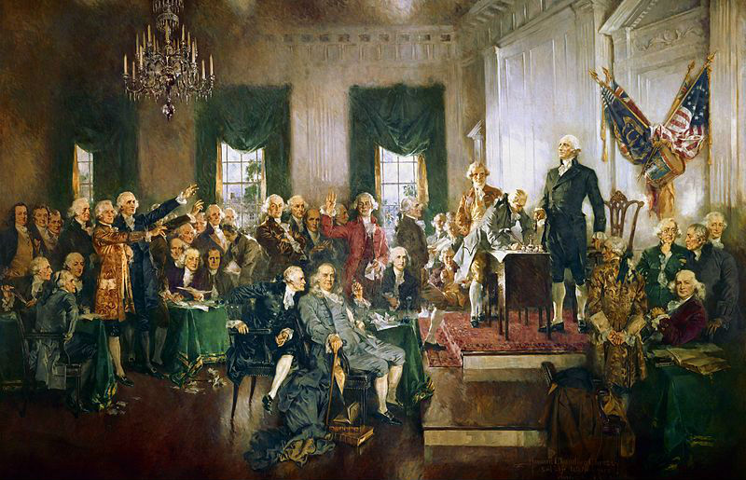
An important challenge facing the Constitutional Convention was how to balance the
Needs of eastern and western states.
Interests of large and small states.
Rights of slaves and slave holders.
Demands of farmers and workers.
Interests of
large and small
states.

Slide 29
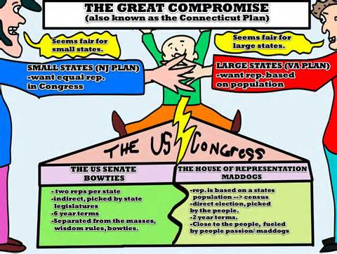
The Great Compromise was primarily related to
Representation in Congress. The election of the president.
The selection of Supreme Court justices Checks and balances.
Representation in Congress.

Slide 30
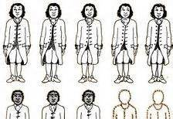
What issue did the Three-Fifths Compromise address?
The manner in which slaves would be counted for taxes and representation
The disagreement over the Virginia Plan and the New Jersey Plan
The disagreement over the Virginia Plan and the New York Plan
The number of branches in the government
The manner in which slaves would be counted for taxes and representation

Slide 31
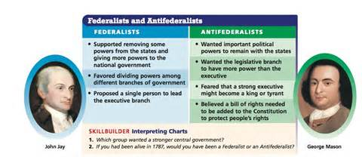
How did the Federalists and the Anti-Federalists express opinions about the U.S. Constitution to the public?
They wrote a series of articles in the newspapers discussing their opinions about the new constitution.
They protested outside of Independence Hall
They wrote a series of articles in the newspapers discussing their opinions about the new constitution.
They posted signs throughout towns asking for support or disapproval of the new constitution.
All of the above

Slide 32
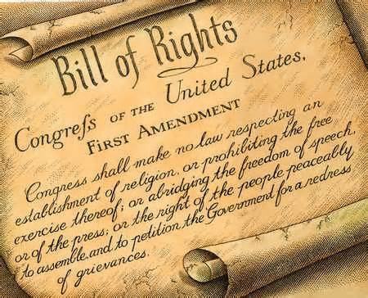
Why did the new government add the Bill of Rights to the Constitution?
Many states wouldn’t sign the Constitution without a bill of rights.
The writers of the Constitution wanted to protect people’s personal rights and freedoms.
Many people believed it was needed to limit the power of the national government.
All are true.
All are true!!

Slide 33
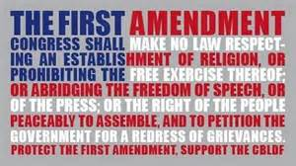
Which of the following would NOT be protected by the First Amendment?
Criticizing government officials on a television talk show
Promoting ideas that many Americans oppose in a political campaign
Falsely crying “Fire” in a crowded theater
Discussing controversial issues in a social studies class
Falsely crying “Fire!!” in a crowded theater

